Slide 1
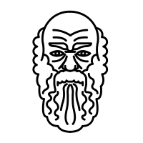
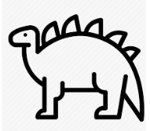
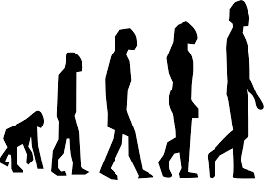
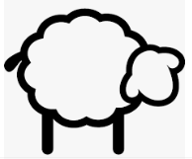
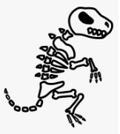
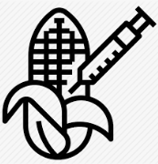
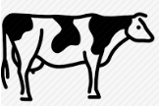
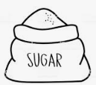
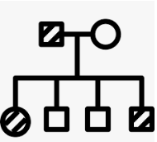
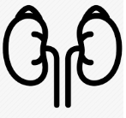
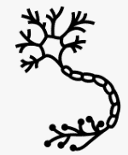
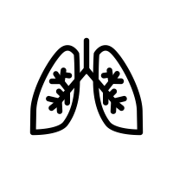
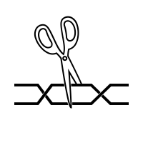
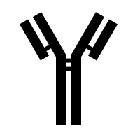
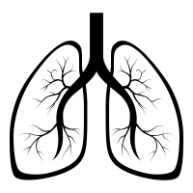
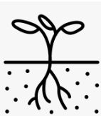
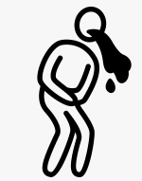
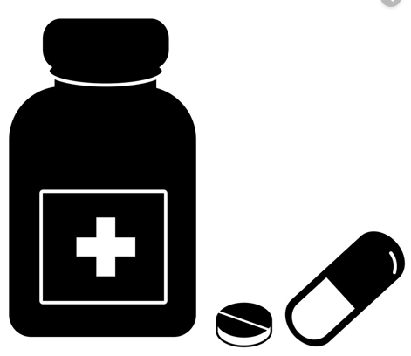
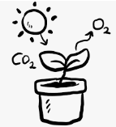
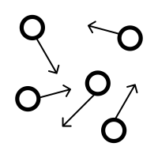
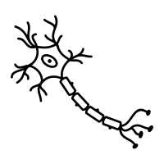
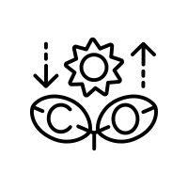
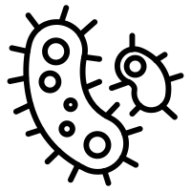
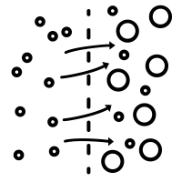
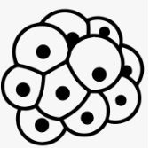
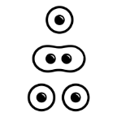
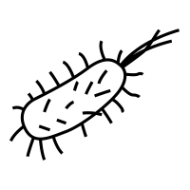
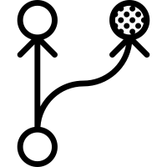
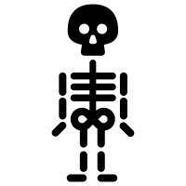
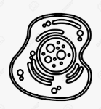
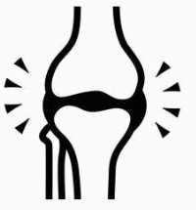
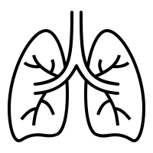
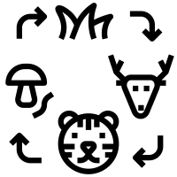
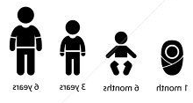
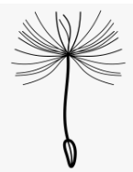
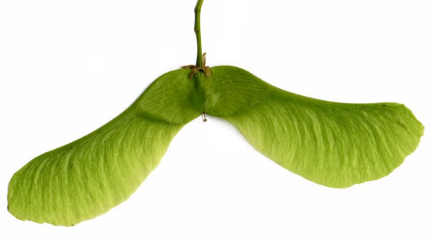
Biology Learning Journey
Year 7
Understanding and Applying Scientific Skills
Year 11
Plant organ systems
Writing methods
Assessing impact of scientific concepts
Understanding relationships between science and society
IDEAL
Identify, describe, explain, apply, link
Risk Assessment
Exam & Post – 16
Destination
Understanding variables
Drawing graphs and analysing graphical data
Analysis of secondary data
Modelling scientific concepts
Drawing conclusions
Applying maths to scientific concepts
Describe and explain patterns
Ethics of genetic engineering
Extinction
Communities
Environmental change
Sustainable fishing
Theories of evolution- Darwin
Speciation
Antibiotic resistant bacteria
Evidence for evolution
Food chains
Water cycle
RP10 Decomposition of milk
Biodiversity
Global warming
Trophic levels
Pyramid of biomass
Farming techniques
Evolution by natural selection
7) Ecology
Biotechnology
& evolution
Cloning
History of genetics
Fossils
Abiotic and Biotic factors
Carbon cycle
Deforestation and land use
Waste management
Transfer of Biomass
Factors affecting food security
Sustainable food production
Selective breeding
Genetic engineering
Classification
RP9 Sampling
variation
Variation
Protein synthesis
RP7 Reflexes
6) Inheritance,
Sex inheritance
RP8 Plant hormones
Balancing water and nitrogen levels
Controlling blood glucose
Genetic disorders
Meiosis
Diabetes
Thermoregulation
The Brain
Homeostasis
11
5) Homeostasis and Response
YEAR
Gene expression and mutations
The genome
Sexual and asexual reproduction
Fertility and IVF
Menstrual cycle
Problems with the eye
Structure and function of the nervous system
Response to exercise
DNA structure
Contraception
Endocrine system
Structure of the eye
Metabolism
Aerobic respiration
Anaerobic respiration
RP5 pH affect on enzymes
Vaccinations
Monoclonal antibodies
RP6 Effect of Light on Photosynthesis
Heart
Lungs
Blood
Lifestyle and disease
Cancer
Pathogens
Drug development
Plant defence
4) Bioenergetics
Maximizing photosynthesis
Enzymes
2) Organisation
3) Infection & Response
Uses of Glucose
Digestive system
Rate of photosynthesis
Specialised exchange surfaces
RP4 Food tests
Blood vessels
Non- communicable disease
Plant tissues and organs
Diseases and symptoms
Human defense systems
Antibiotics and Painkillers
RP2 Testing antimicrobials
Plant disease
Photosynthesis reaction
Active Transport
RP3 Osmosis
Diffusion
Chromosomes
Cell specialisation
Preservation and extinction
Natural selection
Unicellular organisms
1) Cell Biology
Testing leaves for starch
Photosynthesis equation
Stem cells
YEAR
Variation
Diffusion and osmosis
Cell division: mitosis
10
Evolve
Photosynthesis
Plant adaptations
Microscopy
RP1 Microscopy
Prokaryotic and eukaryotic cells
Adaptation and evolution
Atmosphere and food chains
Cells
Organelles
Specialised cells
Plant and animal cells
YEAR
9
Digestive system
Healthy diet
Animal diets
Skeleton
Fitness
Alcohol
Aerobic respiration
Exercise
YEAR
Food and Digestion
Health and Fitness
Respiration
8
Anerobic respiration in yeast and mammals
Energy in food chains
Bacteria and enzymes in digestion
Food tests
Bones and joints
Muscles
Drugs
Lungs
Effects of smoking
Food chains and webs
Living World
Adaptation
The menstrual cycle
Fertilisation and implantation
Levels of organisation
Wind pollination
Plant reproduction
YEAR
Classification
Reproduction
Core Biology
7
Variation
Puberty
Development of a fetus
Reproductive systems
7 life processes
Insect pollination
Seed dispersal

