Slide 1




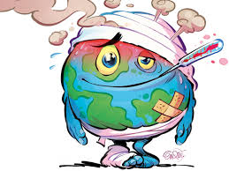




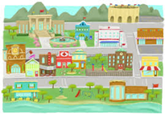


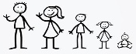




Talking about a future school trip
and drink in a café or market
Revision
Oral & written GCSE exams
French Curriculum map
Volunteering
Ethical shopping
Passive
World issues
Mock exams
Future personal
plans
Vices
Healthy living
School
Revision
Hotels & restaurants
Subjunctive
YEAR
11
French interaction day
Describing an ideal holiday
Jobs & careers
Pluperfect tense
Past, present & future holidays
Describing a school exchange
Imperative
Comparing schools in France and England
Y10 exams & feedback
Present, perfect & future tenses
Role models
Depius + the present tense
Food for
special occasions
Combining different tenses
Community projects
YEAR
Life when you were younger
10
Paris immersion Trip
Using 3
time frames
Free time activities
Describing daily routine
Festivals & traditions
Describing a town
Discussing plans & weather
Arranging & describing a night out
Describing self, family
& friends
Describing relationships
Talking about your musical tastes
Using three tenses in writing
Using three tenses together
Describing what you used to be like
Talking about where I live
Talking about TV & video games
Translation Bee
Paris immersion Trip
Using the present & perfect tenses
Describing what your primary school was like
Using the imperfect tense
Talking about daily routine & moving house
Describing my region
Arranging to go to the cinema
Saying where you went & how
Talking about holidays & what you did
Describing a visit to a theme park
Talking about what you do in your free time & where you do it
Talking about parts & wholes
Talking about nouns you can't count
Saying what you do or did in a typical day
Talking about what groups of people do
Talking about what you & others do at school
YEAR
Arsenal Double Club
9
What is it like?
Formal & informal situations:
Talking to people you do & don't know
Talking about what you are doing this week & what you do every week
Sharing past experiences
People and places in the past
Asking about what happened in the past
Talking about jobs
Saying what people don’t want to, can’t and don’t have to do
Expressing future intentions
Saying people do not do something
What happens & doesn't happen
Talking about what you are doing today vs what you did yesterday
Paris immersion Trip
Using question words
Christmas card competition
Talking about what, when, where & why you celebrate
Talking about how people celebrate
Asking how to say & write new words in French
Distinguishing between being & having
Talking about what people want to, can and must do
Describing things
and people
YEAR
8
Describing people (family)
Saying where people go (places)
Saying where people go (countries)
Talking about yourself, to and about someone else
Saying what people have
Saying what people do
Asking questions
Using question words
Asking questions with subject-verb inversion
Saying how many there are
Saying what people have
Describing things
Distinguishing between having and being
Saying what people do
YEAR
Saying ‘you’ to one &
more than one person
Christmas card competition
International Talent evening
7
Saying what we do
Saying what others do
Distinguishing between having and being Talking about a thing or person
Talking about doing and making things
Describing a thing or person
Asking yes/no questions with raised intonation
One language sets you in a corridor for life. Two languages open every door along the way

