Slide 1
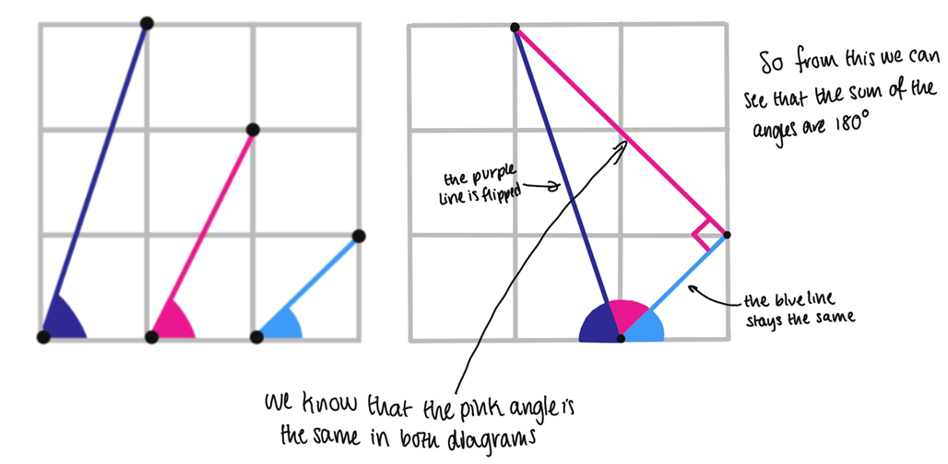
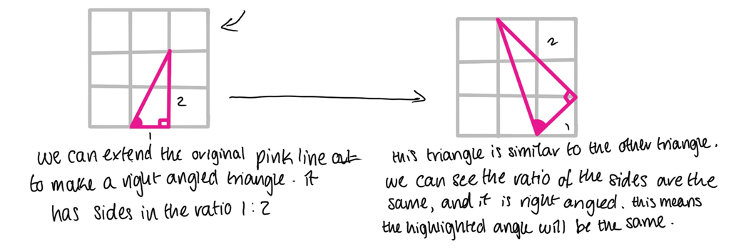
Maths Puzzle of the Week: Last Week’s Puzzle
A superb solution from a Year 10 pupil this week is shown to the left demonstrating that the angles sum to 180 degrees! Without using any trigonometry as well!
Well done to those of you who submitted solutions! Lots of correct answers to a challenging problem!

Slide 2
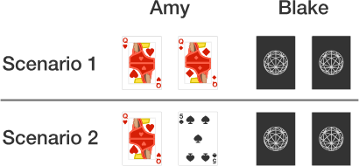
Maths Puzzle of the Week: This Week’s Puzzle
Each week on the bulletin we will be sharing a puzzle for you to do at home – feel free to get your friends, parents, and siblings involved too! We will be awarding merits, as well as half termly and termly postcards for students regularly engaging with the puzzles!
Send us your solutions to MathsSolution@combertonvc.org by 9am on Thursday, and your solution may be featured in the bulletin next week!
Amy and Blake are both dealt two cards from a standard 52 card deck.
Amy’s cards are shown.
In which scenario (1 or 2) is it more likely that Blake has a pair? How do you know?

Slide 3
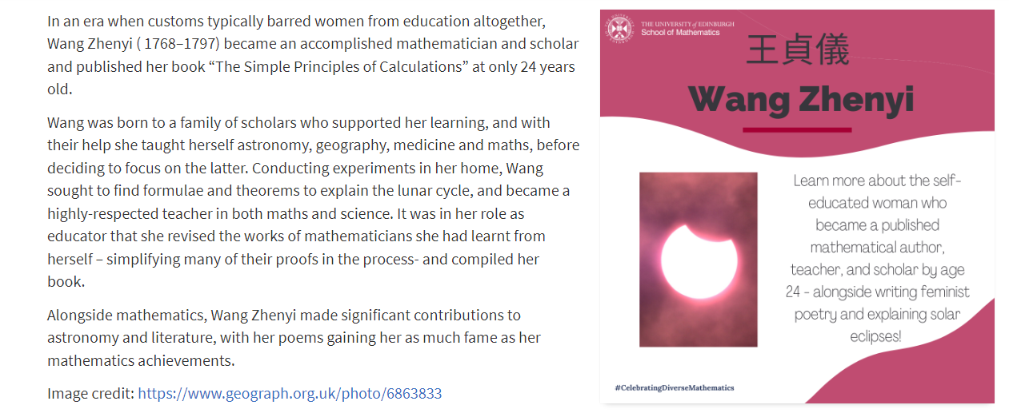
Mathematician Profile of the Week
Each week we will be sharing a profile of a mathematician from history, from a diverse range of backgrounds. These are taken from the University of Edinburgh’s School of Mathematics, who are keen to encourage the celebration of diverse mathematicians. Please do feel free to learn more about these inspirational figures. Let us know if you find out any additional interesting facts about them at MathsSolution@combertonvc.org!

Slide 4
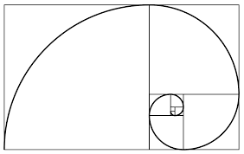
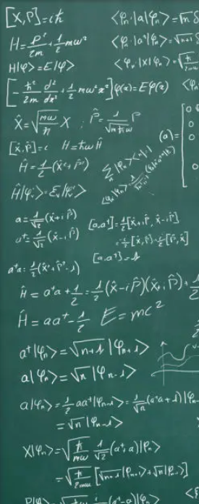

KS3 Maths Problem Solving Club
Are you in Year 7, 8, or 9?
Do you enjoy UKMT maths challenges and solving difficult maths problems in lessons?
Do you enjoy working collaboratively on mathematics?
If so, then please join us in Ma5 on Thursday lunchtimes.
We are also looking for helpers from Year 10 or 11 for this club. Please let Mr Garton know if you or your friends would be willing to help out at cgarton@combertonvc.org

Slide 5
KS4 Girls Maths Club
Are you a female student in Year 9, 10, or 11?
Are you considering taking maths after you leave school?
Do you enjoy working on maths problems collaboratively?
If so, then please join us in Ma5 on Tuesday lunchtimes.
Please contact either Mrs Slusar-Fletcher or Mr Garton if you would like more information!

Slide 6
Year 11 Maths Revision Classes
MONDAY 3-4pm
Ma5 with Mr Garton
WEDNESDAY 3-4pm
Ma6 with Mr White
THURSDAY REG
Six12 with Mrs Datta
THURSDAY LUNCH
Ma1 with Mrs Datta
THURSDAY 3-4pm
Ma7 with Miss Earl
For the afterschool revision classes, please bring along some maths you would like to work on.
This could be a past paper, a homework task, or a worksheet you have been working on in class.

