Slide 1
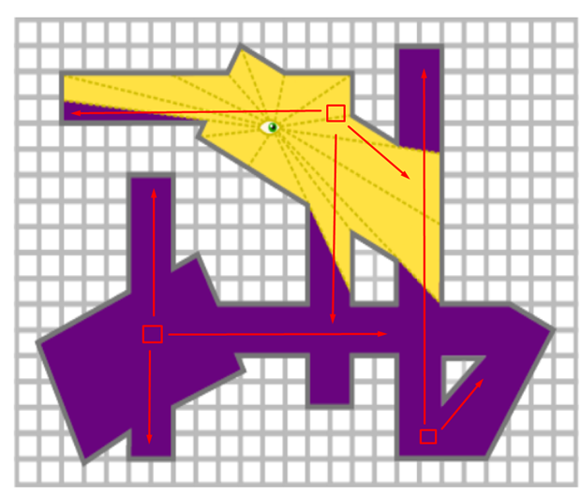
Last Week’s Puzzle
There were some great solutions this week, well done! Most recognised that 3 carefully placed guards was sufficient, such as in the diagram to the right. Many solutions also used 4 or 5 guards.
Well done to those who contributed!
One person noted that if the walls were mirrors, then you could do it with less!

Slide 2

This Week’s Puzzle
Each week on the bulletin we will be publishing a puzzle for you to do at home – feel free to get your friends, parents, siblings, and pets involved too! We will be awarding merits, as well as half termly and termly postcards for students regularly engaging with the puzzles! Send us your solutions to MathsSolution@combertonvc.org by 9am on Thursday, and your solution may be featured in the bulletin next week!
A full jar of honey has a mass of 750g.
The same jar two-thirds full has a mass of 550g.
What is the mass of the empty jar?

Slide 3
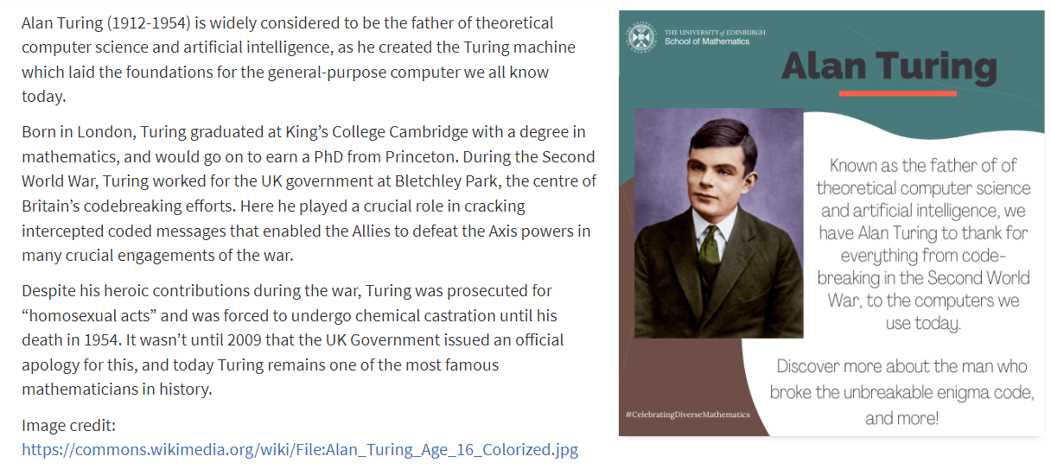
Mathematician Profile of the Week
Each week we will be sharing a profile of a mathematician from history, from a diverse range of backgrounds. These are taken from the University of Edinburgh’s School of Mathematics, who are keen to encourage the celebration of diverse mathematicians. Please do feel free to learn more about these inspirational figures. Let us know if you find out any additional interesting facts about them at MathsSolution@combertonvc.org!

