Slide 1
Prefect Application
Notes:
INTRODUCTION : Charlie

Slide 2
Prefects
This is a great opportunity to take on a leadership role at CVC
You will develop some of the following skills: communication skills, approachable, organised, working as a team, working with peers and staff etc.
There are many different prefect roles on offer from Tour Prefects, Interview Prefects, Event Prefects, Yearbook Prefects, Equality and Diversity Prefects, Environment Prefect, RRS Prefect, Wellbeing Prefect
If you have already applied, you do not need to re-apply.
Notes:
Charlie

Slide 3
Prefect Application Process
Thursday 20th March
Year 10 Head Prefect team lead assembly and advertise the deadline for all other Prefect applications.
Deadline for applications: Thursday 20th April at noon Application and Letter to Mr Law emailed to Mrs Baxter EBaxter@combertonvc.org
For those who have applied for the Head Prefect team, reapplying will not be necessary, but you need to contact Mrs Baxter EBaxter@combertonvc.org to say if you would still like to be consider and what roles you would like to be considered for.
Notes:
Charlie
Shaarah

Slide 5
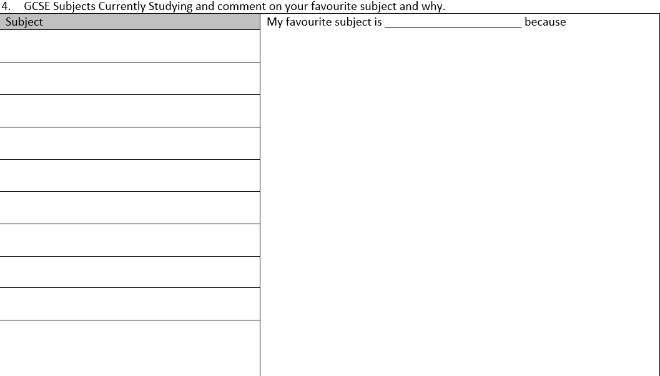

Slide 6
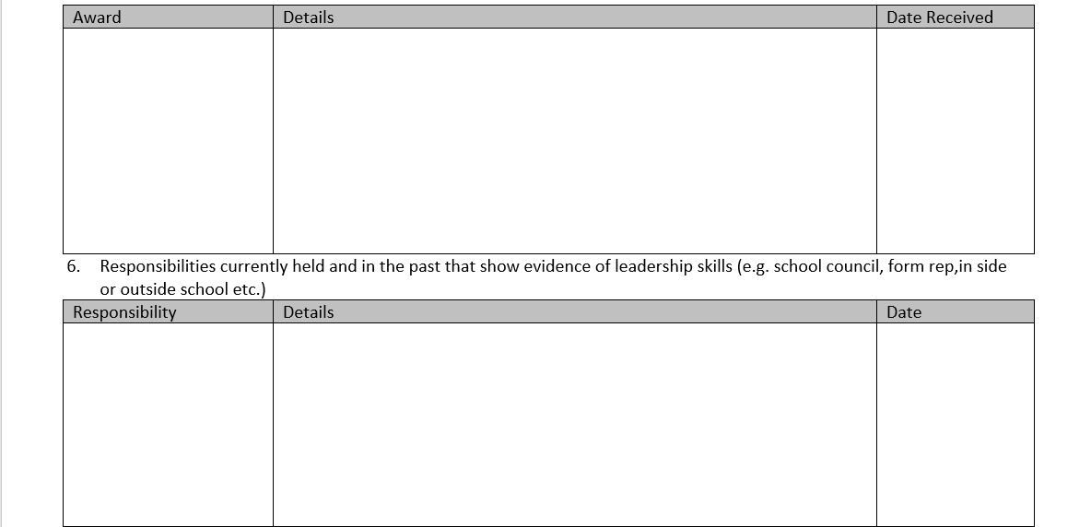

Slide 8
Roles available
Tour Prefects
Interview Prefects
Event Prefects (encompassing open and option, celebration day, winter and may ball)
Yearbook Prefects
Equality and Diversity Prefects
Environment Prefect
Rights Respecting Schools Prefect
Wellbeing Prefect
Notes:
ROLES PART 1 : Diya

Slide 9
Interview Prefects
Lead Member of staff
Head of Student Leadership
Main Duties
Keep an up-to-date record of all interview days within the school
Receive training on how to conduct an interview/ write a questionnaire
To write a plan for different methods to trial to involve pupils
To be involved in several interview days and feeding back to staff your opinions
To recruit and train other prefects and pupils to interview potential staff
To understand fully the confidentiality issues around this post
Notes:
Diya

Slide 10
Tour Prefect
Lead member of staff
Head of Student Leadership
Main Duties
Run all aspects of school tours for Potential staff coming for interview, Potential pupils and their parents and, Overseas and other visitors
Keep a careful diary of all planned visits and to learn about upcoming visits
Lead tours of the school for visitors
Act as a point of contact for all staff who require pupils to conduct tours of the school
Recruit and co-ordinate pupil volunteers from your year and other years for tours (including other prefects)
Train pupil volunteers and other prefects in the key messages about the school that we deliver to visitors
Coordinate with Heads of Department to organise pupils to conduct tours within departments

Slide 11
Events prefect (encompassing open/option evenings, celebration day, winter and may ball)
Lead member of staff
Head of Student Leadership and & Site Managers, HOY/aHOY
Main Duties
Understanding of the requirements for each event/ knowledge of what needs doing, who will do it and by when and coordinating with Senior leaders of School and Site team prior to event.
Oversee the letters and parental consent forms for the pupil volunteers.
Co-ordinate pupil volunteers into a team and train, as necessary.
Meet and greet all parents arriving at the parent and open evenings.
Run all aspects of pupil involvement with the events such as Year 6 open evening (autumn term), Post 16 evening (autumn term), Year 9 options evening (spring term), and evaluating each event afterwards for planning next event
Support staff at open evenings however they need it.
To organise meeting times and agendas for meetings
To work closely with other Year Group Teams on all charity projects,
To work with the AHOY/HOY to manage the budget for the Celebration Day .
To work closely with the AHOY/HOY to book and confirm venue, catering, decoration, entertainment

Slide 12
Yearbook Prefects
Lead member of staff
HOY/aHOY
Main Duties
Coordinate with the ex-Yearbook Prefect in order to get an overview of what is involved in organising the Yearbook
To recruit/manage a team of Year 11 pupils to assist with the organisation of the Yearbook
To organise meeting times and agendas for meetings
To work closely with the AHOY to manage budget for the Yearbook and agree on arrangement for Leavers’ Day
To collect in and finalise photographs for the Yearbook
To organise fund-raising events to help raise money to off set the cost to pupils

Slide 13
Equality and Diversity Prefects
Lead member of staff
Miss Burns
Main Duties
Attend weekly E&D meetings with Ms Burns and E&D team.
To recruit new members to and lead the E&D team.
To organise assemblies and campaigns with Ms Burns and the E&D team.
To work closely with the rest of E&D to delegate responsibilities for research for assemblies.
To promote freedom and expression of individuality within and outside of school.
To collect statements when there is an incident of discrimination or act of hatred within school.
To speak and present assemblies with to all year groups as well as peak to individual forms.

Slide 14
Environment Prefect
Lead member of staff
Mr Gordon
Main duties
To encourage student participation and leadership in transforming the school community’s attitude to environmental issues
Working with the sixth form environment students.
Researching and implementing changes to waste management in the school.
Visiting other institutions to find out how they have met the challenge of reducing their carbon footprint
If you are concerned about environmental issues, want to make a difference, and think that, with a bit of help and support you could talk in assemblies, and meet with teachers and other school staff, this is the role for you.

Slide 15
Rights Respecting Schools Prefect
Lead member of staff
Mrs Burgess
Main duties
Coordinate with Mrs Burgess on Rights Respecting School matters
To attend RRSA meetings twice a half term with Mrs Burgess
To be proactive at finding/reviewing ways in which the Rights of the Child are promoted at CVC
To promote events run in school on RRSA
To prepare and lead assemblies as guided by Mrs Burgess
To support Mrs Burgess with the application of the Gold Award and the sustainment of the Gold Award

Slide 16
Wellbeing prefect
Lead member of staff
Mr Beamish
Main duties
To Coordinate with Mr Beamish on student mental health and wellbeing issues
To attend Wellbeing meetings once per half-term with Mr Beamish
To prepare and present assemblies on positive wellbeing
To promote events run in school about mental health and wellbeing
Support investigating student wellbeing matters via the whole school wellbeing surveys
To advise on developing strategies and policies to support with positive mental health and wellbeing in the school.

Slide 17
Prefect Application Process
Thursday 20th March
Year 10 Head Prefect team lead assembly and advertise the deadline for all other Prefect applications.
Deadline for applications: Thursday 20th April at noon Application and Letter to Mr Law emailed to Mrs Baxter EBaxter@combertonvc.org
For those who have applied for the Head Prefect team, reapplying will not be necessary, but you need to contact Mrs Baxter EBaxter@combertonvc.org to say if you would still like to be consider and what roles you would like to be considered for.
Notes:
Charlie
Shaarah

