Slide 1


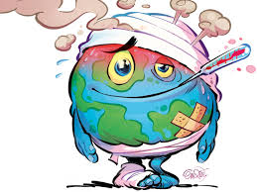
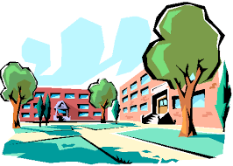







Talking school trip
Ordering food and or maring ventskeAAsking questions about what people did
sking questions about what people did
t
Revision
Oral & written GCSE exams
Spanish Curriculum map
Pluperfect tense
Sporting events
Vices
Local actions
Global issues
Indirect object pronouns
Jobs & work experience
Food & mealtimes
Revision
Shopping
YEAR
Describing towns, regions & their problems
Subjunctive
11
Spain work experience trip
Healthy eating & lifestyles
Role models
Gap years & future plans
Learning languages
Festivals & celebrations
Y10 exams & feedback
Conditional tense
TV programmes & films
Describing your school & uniform
Rules, problems & exchanges
Present continuous
Soler + infinitive
YEAR
Hobbies & sport
Using 3
time frames
10
Spanish interaction day
Dali trip
School subjects & teachers
Negatives
Social networks & arranging to go out
Reading
People, family & friends
Accommodation & problems
Typical & past holidays
Holiday preferences
Describing your school
Using the preterit
Birthdays
Recycling
Children’s rights
My family
Describing my routine
How a town has changed
Spanish exchange
Language Leaders
The present tense
Se debería
Fair trade
Films
Describing people
School subjects & opinions
What I like
Talking about myself & my birthday
Describing my pets & my holuse
Saying what you do for others
Routines and daily life
Talking about giving & receiving (Birthdays)
Describing how things make people feel
YEAR
9
Arsenal Double Club
Dali trip
Describing what different people did in the past (Free time activities)
Talking about the environment
Describing a series of events (Narration)
Giving opinions about school
Talking about what people do (work)
Describing how people feel in the present (feelings & emotions)
Asking what people can & must do
Talking about what people & places are like now vs in general.
Describing what people do (technology & social networks)
Christmas card competition
Translation Bee
Describing events in the past & present (travel)
Comparing past experiences
Describing future plans
Describing events in the past & present (at school & free time activities)
Comparing what you & someone else (‘we’) do (news and media, parties and celebrations)
Describing what people do (at home)
YEAR
8
Saying what people are like today vs in general
Describing activities (travel)
Describing what people do (technology)
Describing when & where people go
Places & locations
Valencia trip
Talking about what people can do
Contrasting what people must, can & want to do
Describing what people do
Describing people and possessions
Describing future plans
Describing family & some natural wonders of the Spanish-speaking world
Saying what there is around you & describing it Talking about the location of things
Saying what people have & do
Describing places & location
Christmas card competition
YEAR
Spelling Bee
International Talent evening
7
Talking about what you do with others (rural life)
Asking & answering questions
Describing a place Giving & wanting (festive season & family)
Saying what people do and don't do
Numbers ( 1 to 12) and talking about more than one thing
Saying what someone is like at the moment & in general
One language sets you in a corridor for life. Two languages open every door along the way

