Slide 1
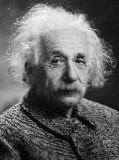
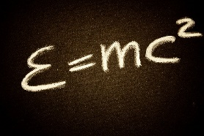
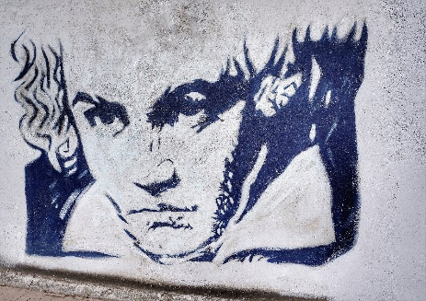
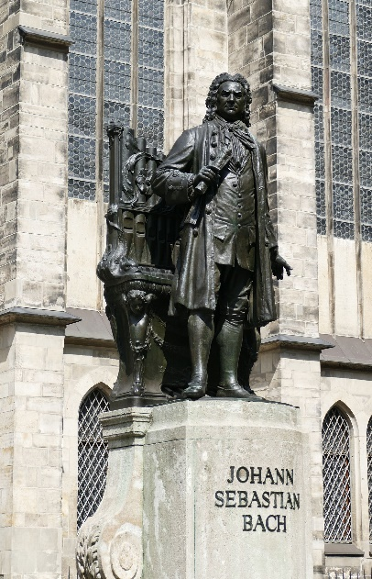
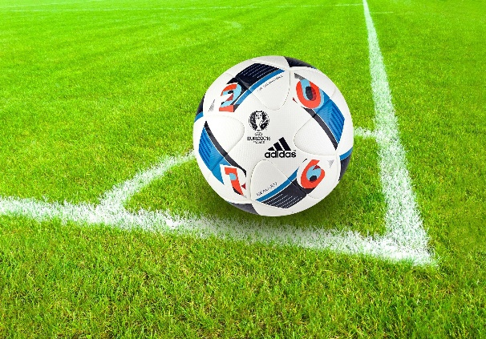
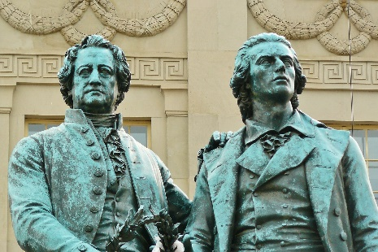
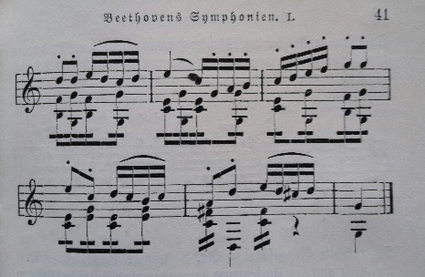
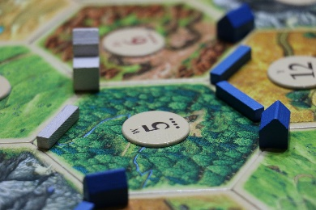
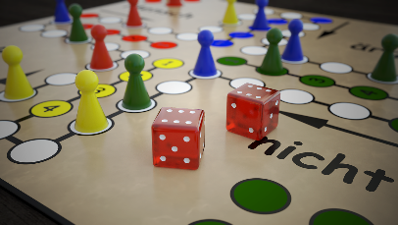

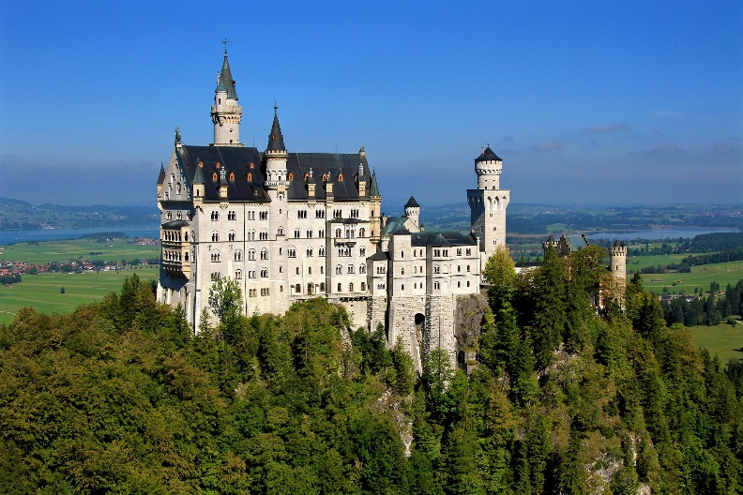
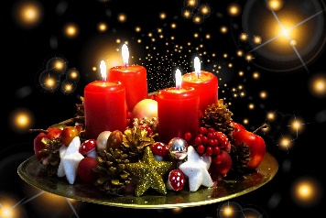
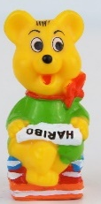
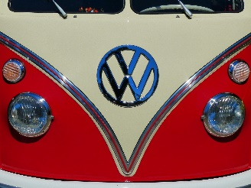
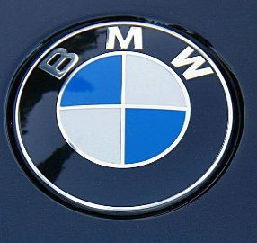
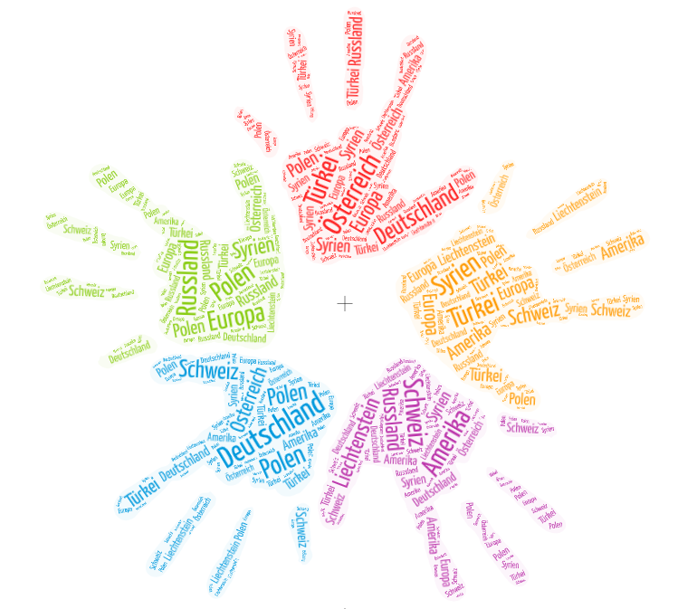
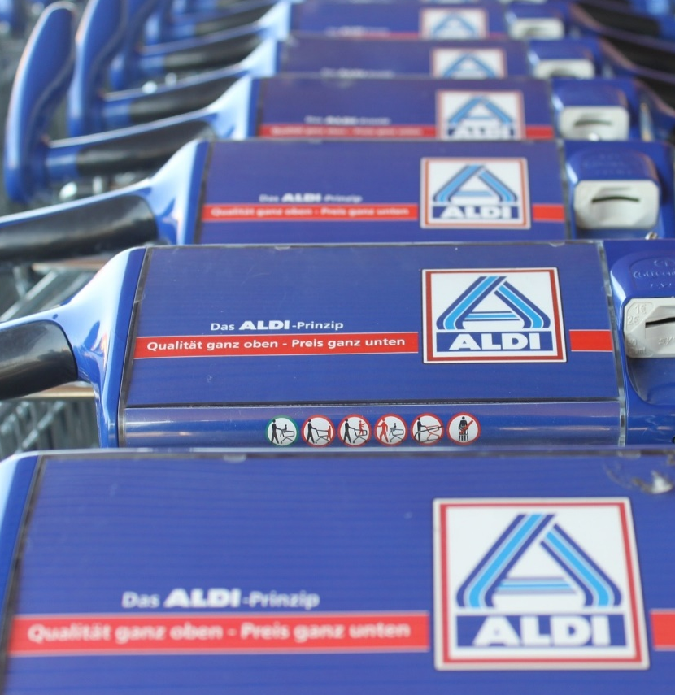


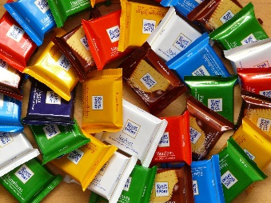

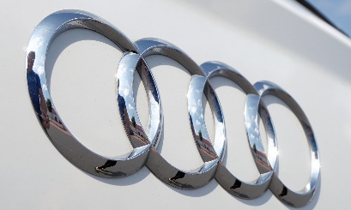


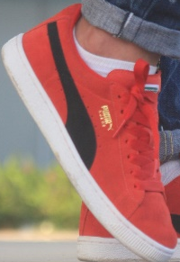
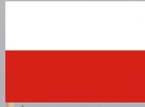


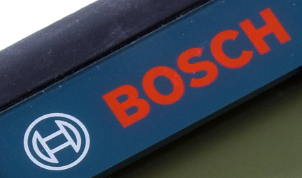
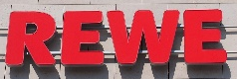



Deutsch
Sportler
Denker
Musiker
Erschaffer
Dichter
traditionell
multikulturell
Erschaffer
Techniker
Techniker
Year 9 Language Guide
Name: …………………………………………..
Lehrer/Lehrerin: ……………………
Last updated: 13/07/21
Notes:
Word Frequency Source: Jones, R.L & Tschirner, E. (2019). A frequency dictionary of German: Core vocabulary for learners. London: Routledge.

Slide 2
Overview | Theme / Topic
Autumn 1 | Talking about exchanging gifts Saying what we think about things; asking and answering questions Comparing places and people now and then Explaining what you did/used to do Comparing places and people now and then
Autumn 2 | Saying how well and how willingly you and others do things Talking about what you and others prefer to do; asking and answering questions Comparing what you do now with what you used to do Talking about what you do, when you started and how long you've been doing things Understanding a non-fiction text
Spring 1 | Talking about plans for this weekend Talking about what I and someone else wants vs what I have to do at home Dreams and plans: comparing what we want to do with what we will actually do What is it like? Describing attributes Tell me more: describing attributes in more detail
Spring 2 | Location and direction: talking about where you were and where you went and why Narrating past events; asking and answering questions Planning an event on a budget; comparing the ideal and real; talking about roles - what you and others will do Dreams and goals Writing about the things that are important to you
Notes:
Version Bi

Slide 3
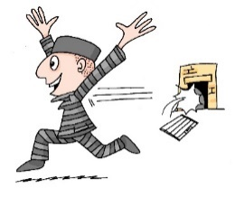
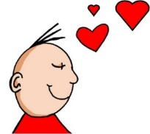


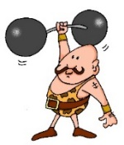

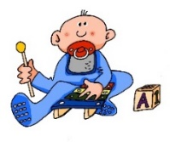




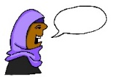






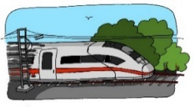


Sounds of the language
In Y8, SSC knowledge is further developed by activities focused on two or more SSC. Often these are tricky pairs, such as EI/IE, V/W. In some weeks, several SSC are revisited.
These are the SSC we focus on, in particular:
[ei] | [ie]
[s] [ß] | [sch] | [sp-] | [st-]
[u] | [u] | [ü]
[ai] | This is the same sound as [ei] | [r] | [r]
[w] | [v]
[z] |  | [ch]
frei
Liebe
sollen
groß
schreiben
spielen
stark
du
Punkt
Tür
fünf
Haifisch
reden
Uhr
Welt
vor
Pronounce cognates ending in –tion with a –ts in German, like the German [z]
Zug
ich
Buch
4

Slide 4
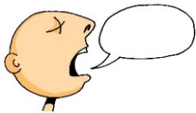

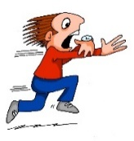

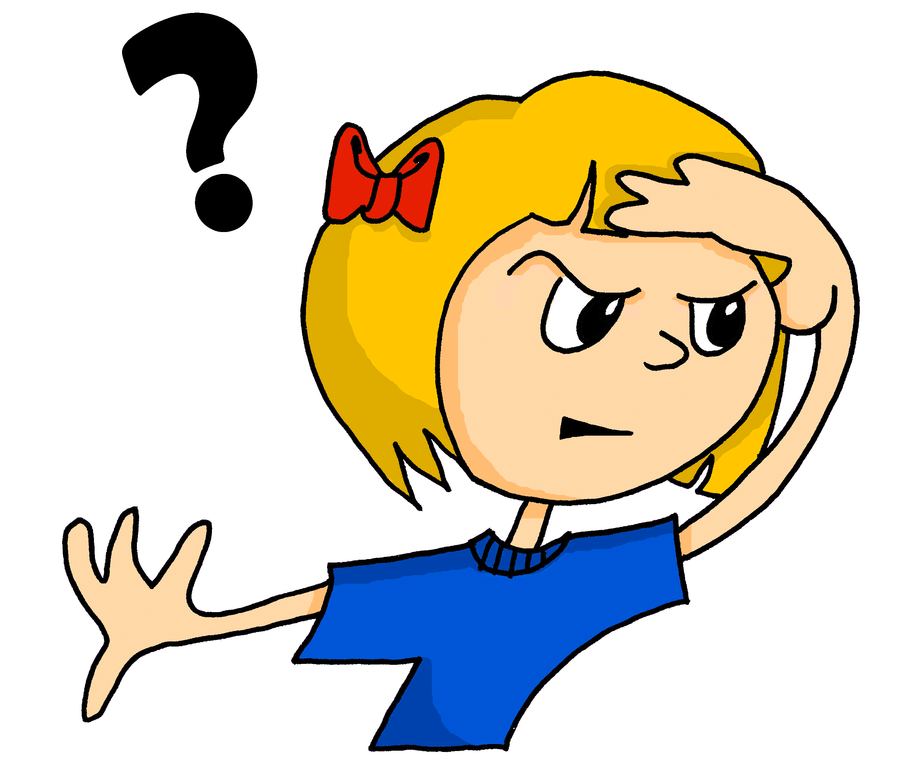
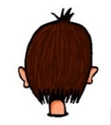







Sounds of the language cont’d
German vowels
Remember! As you know, German vowels can be long or short.
Vowels followed by more than one consonant are short.
Other vowels are long.
[a] | [a] | [ä] | [ä]
[o] | [o] | [ö] | [ö]
[er] | [-er]
[-ig]
[i] | [i] | [ie]
sagen
kalt
spät
lächeln
wo?
Kopf
schön
plötzlich
[suddenly]
er
wieder
At the start or in the middle of words, German [g] is usually like the ‘g’ in English ‘go’, including in cognates, and your vocal chords vibrate.
However, when [g] is the final sound in the word, it sounds more like ‘k’, and you don’t use your vocal chords.
richtig
wir
finden
Liebe
Other pairs and combinations of sounds we practise in Y8 are:
ZW | SCHW
CH | CK
PF-KN
EU | ÄU
F | V
V | W
-D | -D-
Y
-E | -ER
Z | S-
Ä| E
5

Slide 5
Word patterns and word families
To develop vocabulary knowledge, we focus explicitly on some common word patterns between German and English. The words are high-frequency and often cognates or semi-cognates with English. The words' meanings may be learnt incidentally, but the words are not necessarily included in the planned vocabulary set to be taught, practised, and learnt intentionally that week. We also develop learners’ knowledge of word families (any parts of speech connected by a common, semantically-related stem).
Pattern | Examples
Compound nouns | Brieffreund, Gastmutter, Abendbrot, Wohnzimmer
English ‘C’ → German ‘K’ | Oktober, Diskussion, Projekt, Kontakt, Artikel
Nominalisation of verbs | Schwimmen, Lesen, Laufen, Schreiben, Sprechen
Add ‘-in’ to masculine people nouns | Journalistin, Sängerin, Schülerin, Direktorin
Make adjectives negative with ‘un’ | unpraktisch, unfreundlich, unmöglich
Englisch ‘C’ → German ‘Z’ | Prinzip, sozial, zentral, Konzept
Cognates ending -tion | Generation, Organisation, international, Situation
Noun and verb pairs (verb stem = noun) | Arbeit (arbeiten), Besuch (besuchen), Plan (planen), Spiel (spielen)
Noun and verb pairs (2): -ung nouns | Meinung (meinen), Lösung (lösen), Bildung (bilden), Beschreibung (beschreiben)
6

Slide 6
Word patterns and word families cont’d
Pattern | Examples
-ical in English to -isch in German | musikalisch, klassisch, historisch, typisch, praktisch
Make adjectives into nouns | die Kleinen, die Armen, die Reichen
-ty or –ness in English → -heit | Sicherheit, Einheit, Krankheit, Mehrheit
-ght in English → -cht | Nacht, Licht, acht, richtig, Recht, Macht, leicht
Word family: Freund | Freund(in), (un)freundlich, Freundschaft, tierfreundlich, Freundenkreis, Schulfreund, Brieffreund, freundlicherweise
Noun and verb pairs (3): verb stem +e as noun | Rede (reden), Liebe (lieben), Ende (enden), Frage (fragen)
Prefix Haupt-meaning ‘main’ | Hauptstadt, Hauptwort, Hauptziel, Hauptrolle, Hauptproblem, Hauptgrund
Suffix –weise for adverbs | teilweise, beispielsweise, normalerweise, möglicherweise
-(al)ly in English → -lich in German | täglich, nördlich, natürlich, persönlich, endlich
Verbs ending in -ieren | studieren, trainieren, organisieren, kritisieren, existieren, interessieren, informieren
7

Slide 7
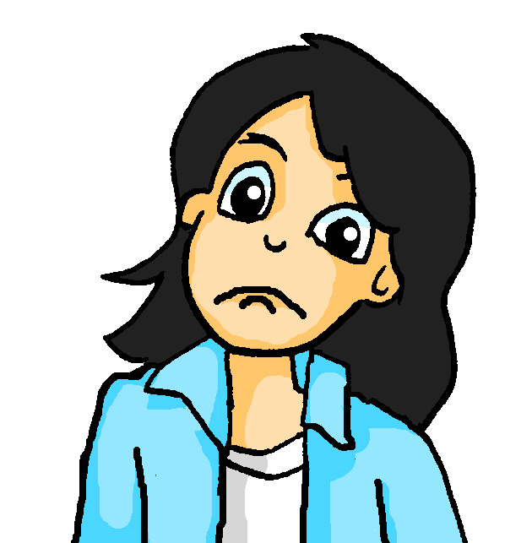
T2.1 Woche 1
Grammatik
Indirect pronouns – R3 (dative)
After certain verbs, use indirect object R3 (dative) pronouns:
SUBJECT
VERB
OBJECT
Ich
antworte
dir.
I answer you.
Du
antwortest
mir.
You answer me.
Ich
antworte
ihm.
I answer him.
Ich
antworte
ihr.
I answer her.
Sometimes these R3 (dative) pronouns mean ‘to me’, ‘to you’ etc., but they can just mean ‘me’, ‘you’, ‘him’, ‘her’.
mir
(to) me
dir
(to) you
ihm
(to) him, (to) it
Mutti,
ich antworte ihm!
ihr
her, (to) her, you (pl. fam.)
Wolfgang, ich antworte dir!
To identify whether a verb is a R3 (dative) verb, it can help to ask, ‘Can you do or give this to/for someone else?’
E.g. Ich danke ihm - I thank him = I give thanks to him.
But you may find it better just to learn these R3 verbs as a set.
33

Slide 8
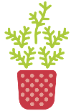
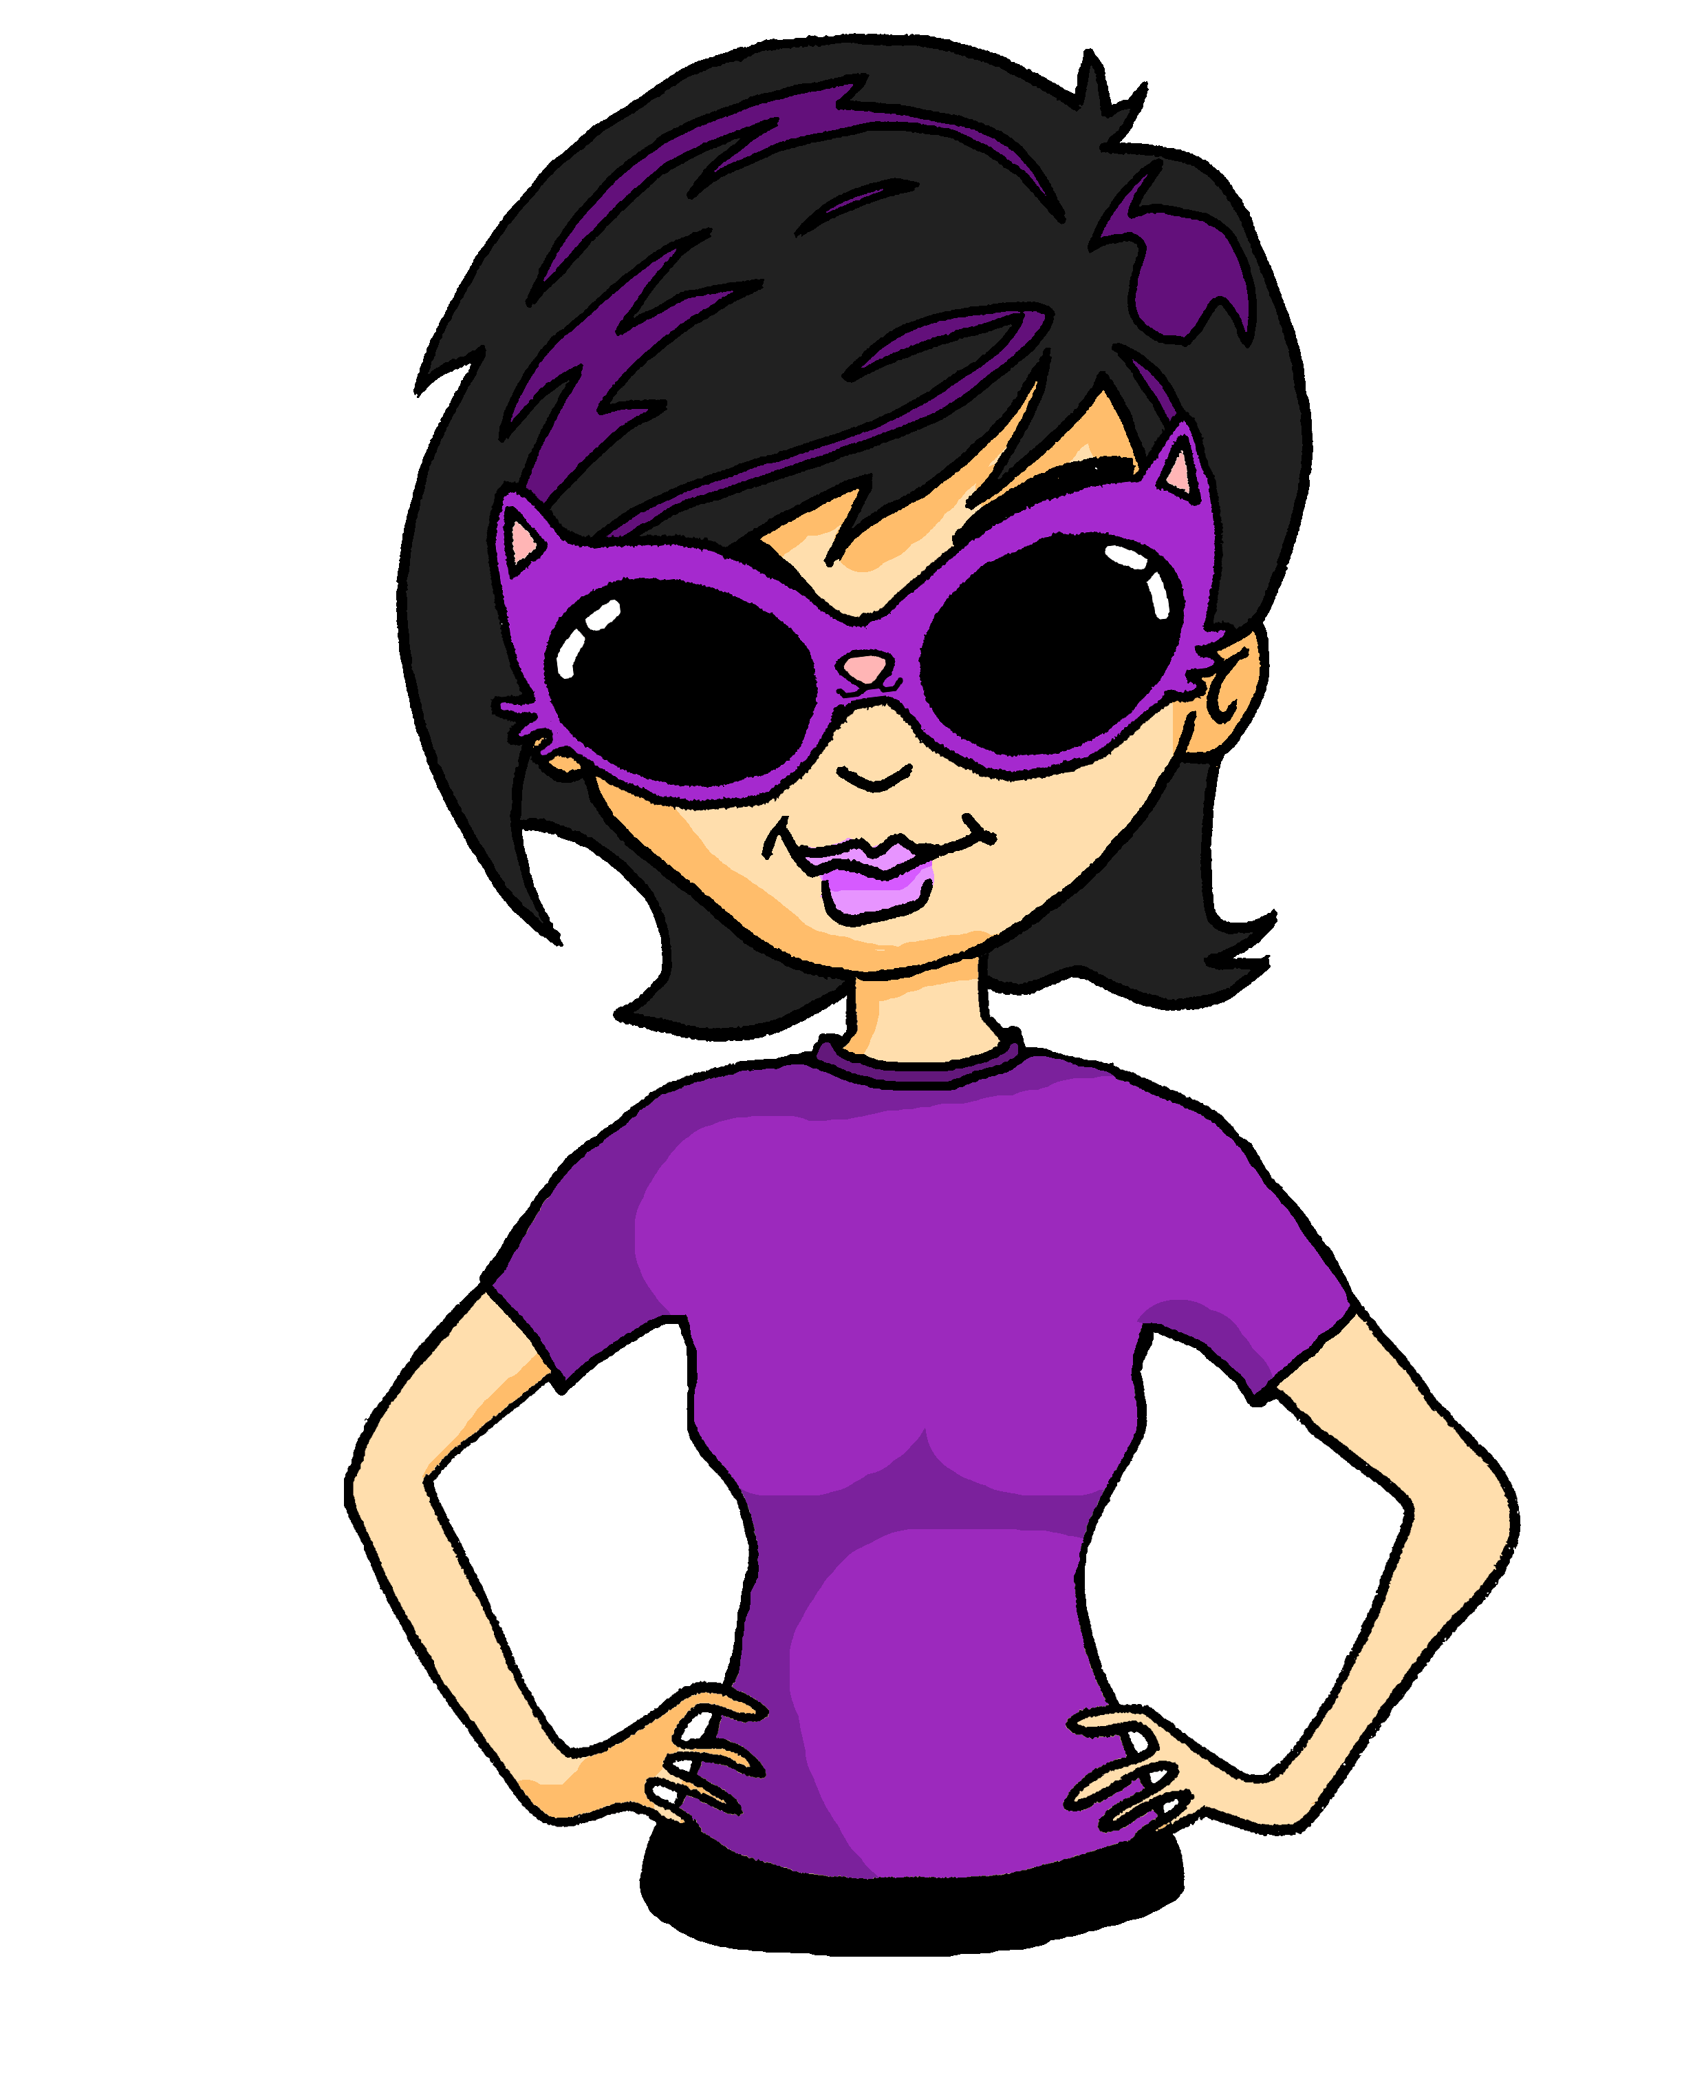



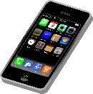

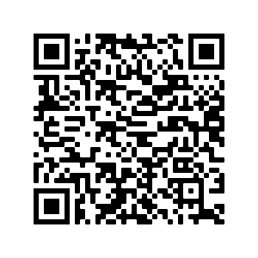

Prepositions von and für
Eine Pflanze für meine Mutter!
The preposition für (to/for) is always followed by R2 (accusative).
The preposition von (from/of) is always followed by R3 (dative).
Ein Kuchen von meiner Mutter!
Possessive adjectives in R2 (accusative) & R3 (dative)
Possessive adjectives (mein, dein, sein, ihr) follow the same pattern as the indefinite article ein – they change according to gender:
R2:
R3:
Das ist für meinen Vater.
Das ist für meine Mutter.
Das ist für mein Handy.
Das ist von meinem Vater.
Das ist von meiner Mutter.
Das ist von meinem Handy.
Talking about exchanging gifts
Vokabeln
vb
antworten | to answer, answering
danken | to thank, thanking
kriegen | to get, getting
schenken | to give, giving
dir | (to) you
ihm | (to) him, (to) it
ihr | (to) her
die Uhr | o'clock, clock, watch
eigen | own
für | for
vb
vb
vb
pron
pron
Revisit vocab 8.1.2.4 & 8.1.1.5.
pron
nf
adj
prep
34
Notes:
antworten [826] danken [1276] kriegen [724] schenken [1614] dir [244] ihm [91] ihr [27] Uhr² [348] eigen [166] für [17]

Slide 9


T2.1 Woche 2
Grammatik
Verbs with indirect objects (2)
Remember certain verbs use indirect object (R3/dative) pronouns:
Das Buch
hilft
mir.
The book
helps
me.
Das Buch
gehört
mir.
The book
belongs
to me.
Sometimes ‘mir’ translates as ‘me’ and sometimes as ‘to me’.
Opinions with ‘dass’ (that)
Use the verbs denken (think), glauben (believe) and meinen (have the opinion) to say what you think.
The conjunction dass sends the verb to the end - (Word Order 3):
WO1 (no ‘dass’):
WO3 (with ‘dass’):
Ich denke, Sport ist lustig.
Ich denke, dass Sport lustig ist.
I think sport is enjoyable.
I think that sport is enjoyable.
Another WO3 conjunction you know is weil:
Ich denke , dass Sport lustig ist , weil es fit macht.
I think that sport is enjoyable because it makes (you) fit.
In German, there is always a comma after an opinion verb. Spot the around the commas above!
35

Slide 10
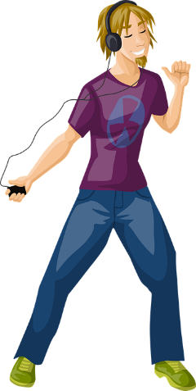


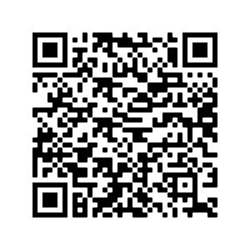
Making nouns from infinitives of verbs
Er mag tanzen.
Tanzen ist leicht.
You can often make nouns from the infinitive of verbs.
He likes to dance / dancing.
Dancing is easy.
All nouns made from infinitive verbs are ‘das’. However, they are usually used without the indefinite article, as in English.
Saying what we think about things
Vokabeln
vb
fehlen | to lack, be missing, be absent
gefallen | to please, pleasing
gehören | to belong, belonging
meinen | to think, have an opinion
tun | (to) do, doing
die Meinung | opinion
das Leid | sorrow, grief
fit | fit
schwer | difficult¹, heavy²
weh | sore, hurt
dass | that
vb
vb
vb
vb
nf
nnt
adj
adj
Revisit vocab 8.1.2.5 & 8.1.1.6.
adj
conj
36
Notes:
fehlen [420] gefallen [601] gehören [460] meinen [213] tun [123] Leid [1300] Meinung [787] fit [4080] weh [2798] dass [22] schwer [257]

Slide 11
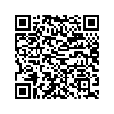
T2.1 Woche 3
Grammatik
In / auf + R2 (accusative) and R3 (dative)
in das → ins
Use Row 2 when describing motion into / onto:
 |  | masculine | feminine | neuter
R1 |  | der Garten | die Schule | das Theater
R2 | Ich gehe | in den Garten | in die Schule | ins Theater
 |  | in einen Garten | in eine Schule | in einem Theater
Use Row 3 when describing location in / on something:
R3 | Ich bin | im Garten | in der Schule | im Theater
 |  | in einen Garten | in eine Schule | in einem Theater
in dem → im
Look back at pp. 8-9, 21, 23, 27 to recap how to form to perfect tense. These are the strong past participles you have learnt so far:
mit haben
mit sein
sehen
singen
finden
laufen
gehen
gesehen
gesungen
gefunden
gelaufen
gegangen
treffen
trinken
geben
fahren
bleiben
getroffen
getrunken
gegeben
gefahren
geblieben
liegen
essen
helfen
fliegen
steigen
gelegen
gegessen
geholfen
geflogen
gestiegen
schreiben
sprechen
schwimmen
geschrieben
gesprochen
geschwommen
37

Slide 12
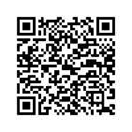
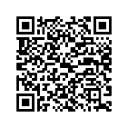
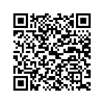


T2.1 Woche 5
Grammatik
For T2.1 Woche 4 revise:
The Imperfect tense: using war (was), hatte (had), es gab (there was)
Berlin hatte einen Marktplatz.
Berlin had a market square.
Es gab ein Museum.
There was a museum.
Das Museum war groß.
The museum was big.
It is handy to use this one-word past tense to describe places, people and things in the past.
Use the adverb früher (in former times) with the past (imperfect) tense to say ‘used to’:
Früher hatte Berlin einen Marktplatz.
Berlin used to have a market square.
Es gab früher ein Museum.
There used to be a museum.
Das Museum war früher groß.
The museum used to be big.
38

Slide 13
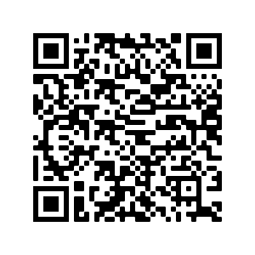
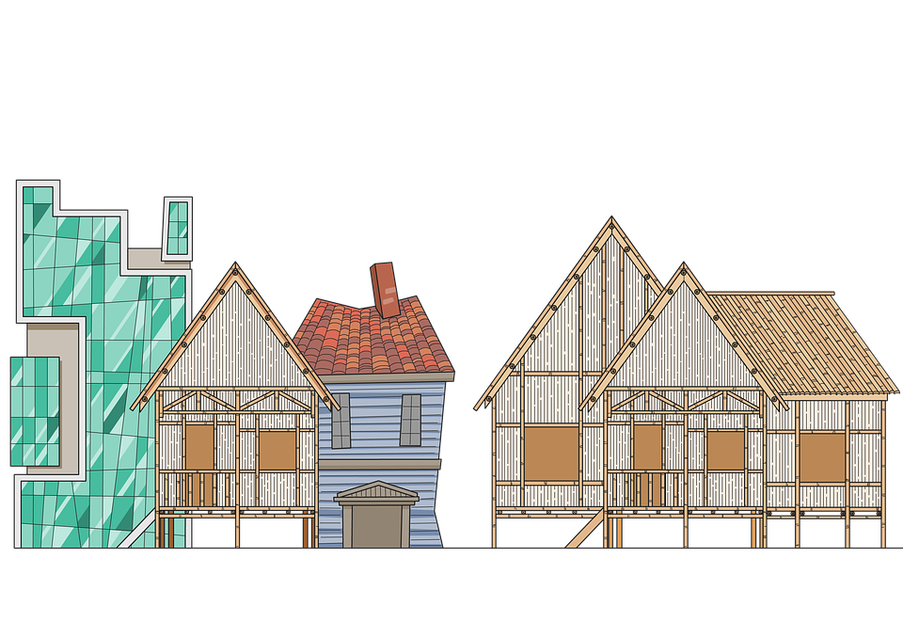
Comparing places and people now and then
Vokabeln
vb (imp)
es gab | there was, there were
hatte | had
war | was
heiß | hot
kalt | cold
nah | near(by), close
tief | deep
voll | full
wenig | few
damals | back then
früher | in former times
links | on/to the left
rechts | on/to the right
vb (imp)
vb (imp)
adj
adj
adj
adj
adj
adj
adv
adv
adv
adv
Revisit vocab 8.1.2.7 & 8.1.1.7.
39
Notes:
es gab [49] hatte [6] war [4] heiß [1195] kalt [887] nah [480] tief [442] voll [388] wenig [102] damals [286] früher [411] links [893] rechts [829]

Slide 14


T2.1 Woche 6
Grammatik
Comparative adjectives
Add –er to an adjective or adverb to form the comparative:
Das Auto ist billig.
Dieses Auto ist billiger.
The car is cheap.
This car is cheaper.
Das Haus ist teuer.
Dieses Haus ist teurer.
The house is expensive.
This house is more expensive.
Spelling differences:
-e → -er – müde → müder
-el → -ler – dunkel → dunkler
-er → -rer – teuer → teurer
(if -er preceded by a vowel).
To compare two things, use als to mean than:
Die Stadt ist sicherer als damals.
The town is safer than back then.
Most single syllable comparatives add an umlaut, e.g.:
lang: länger (longer), groß: größer (bigger), kurz: kürzer (shorter)
But these four comparatives are completely different:
gut: besser (better), viel: mehr (more), hoch: höher (higher), gern: lieber (prefer)
40

Slide 15
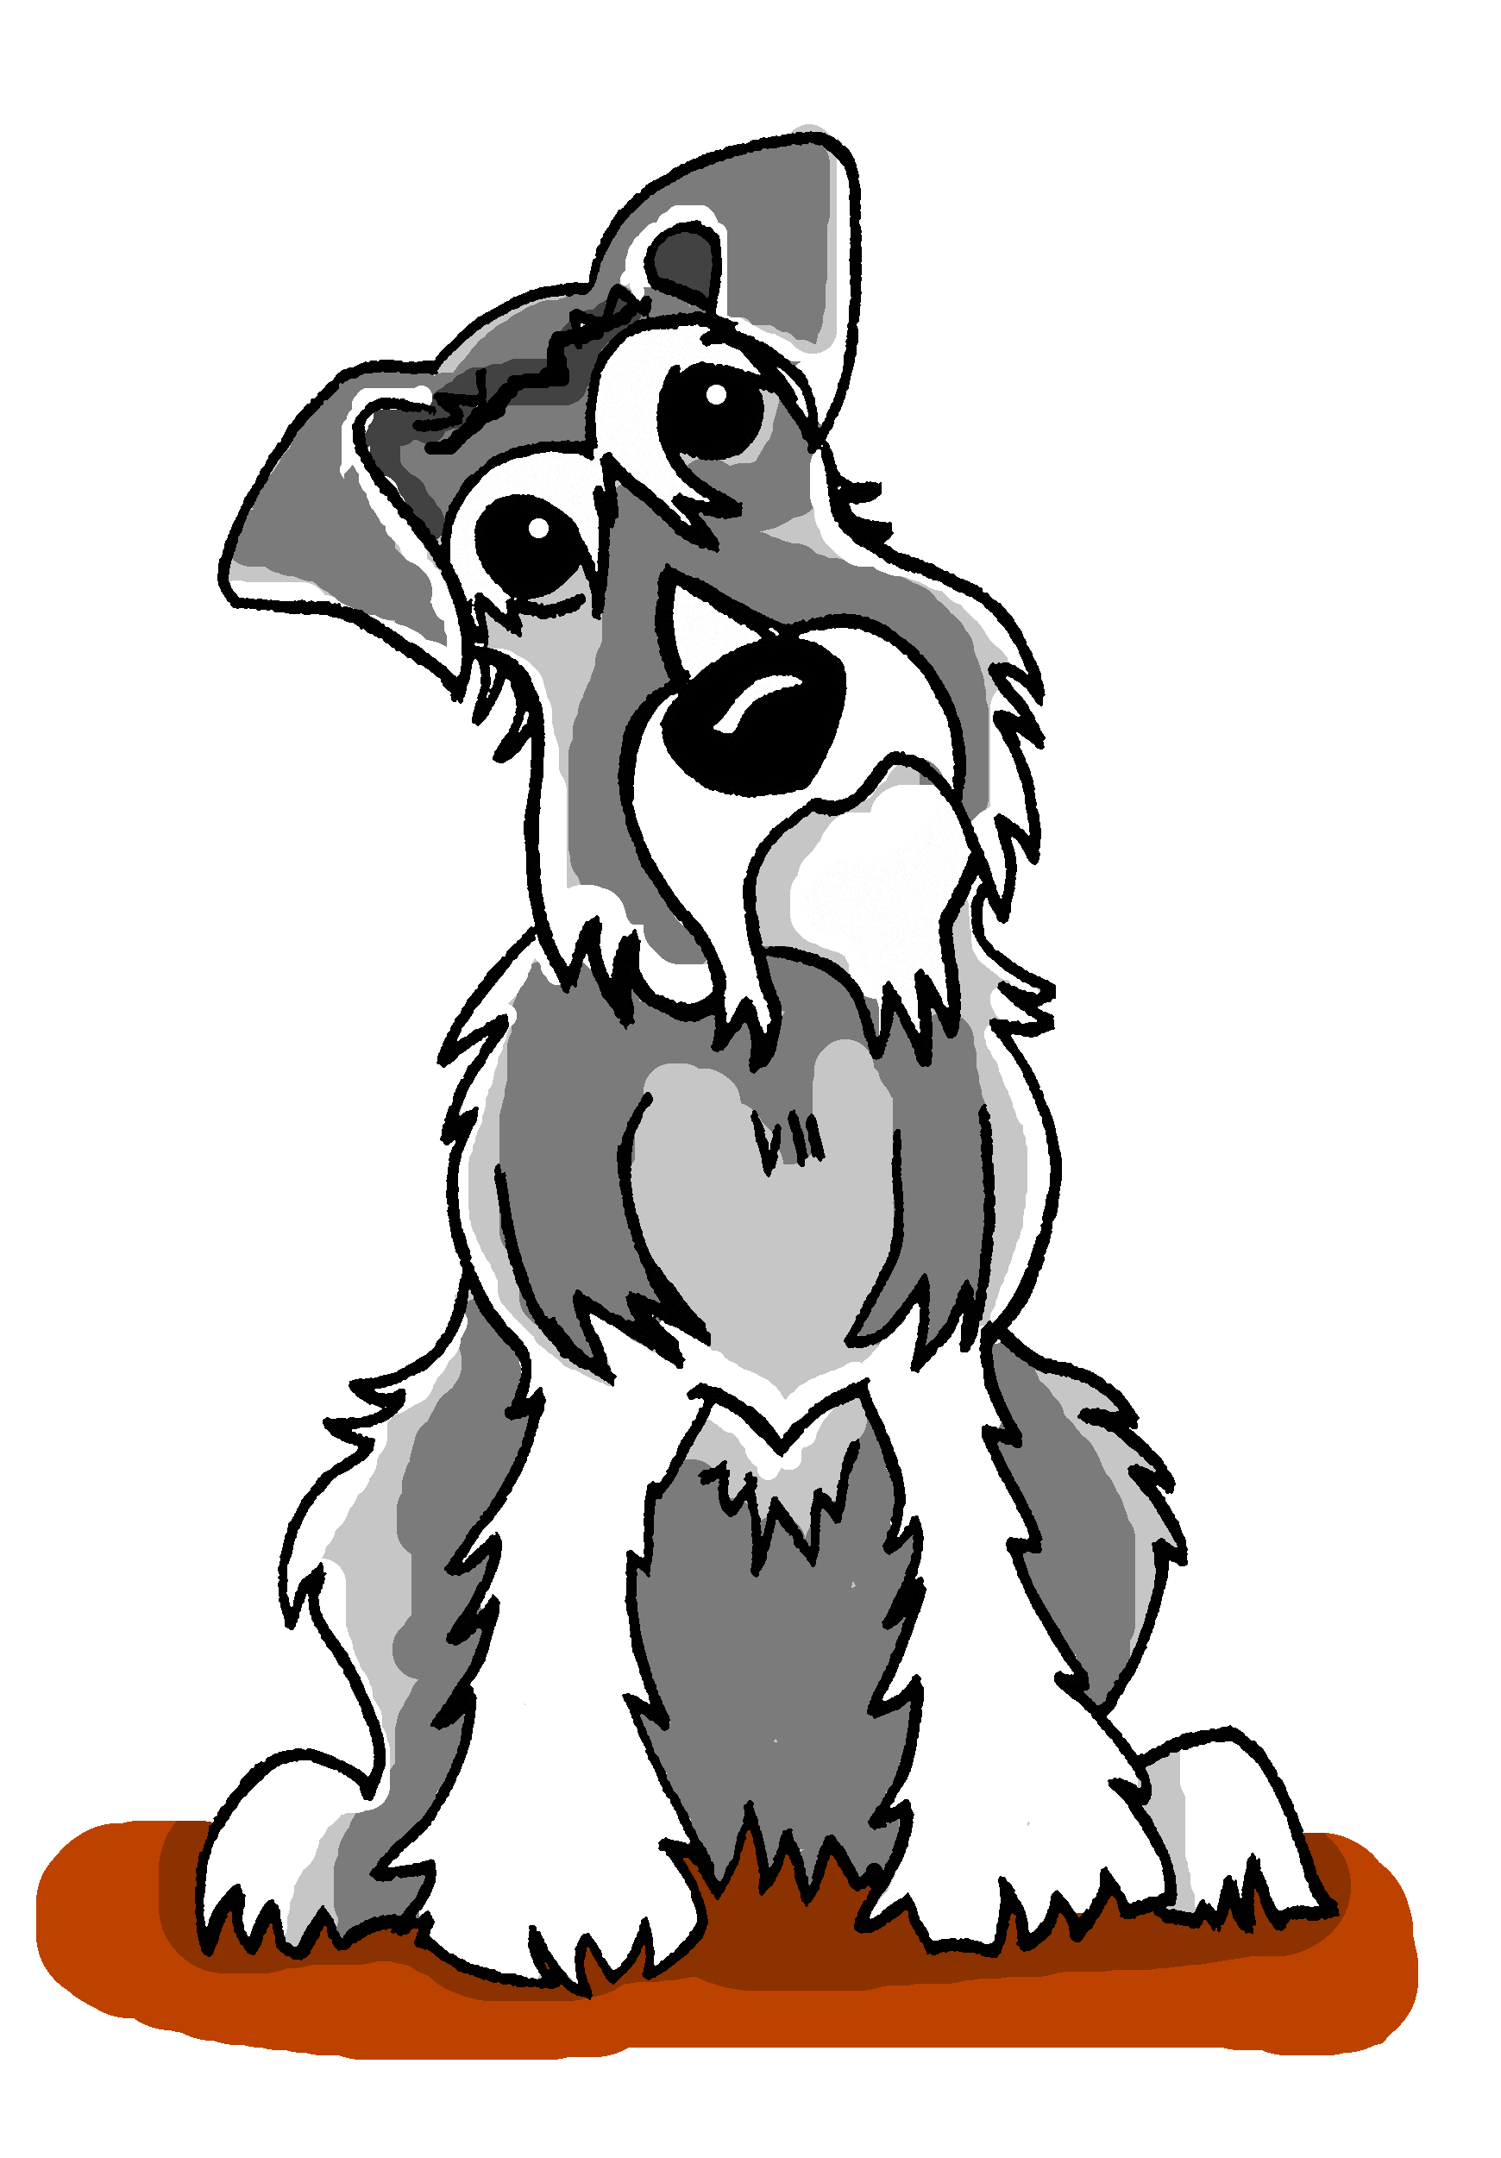
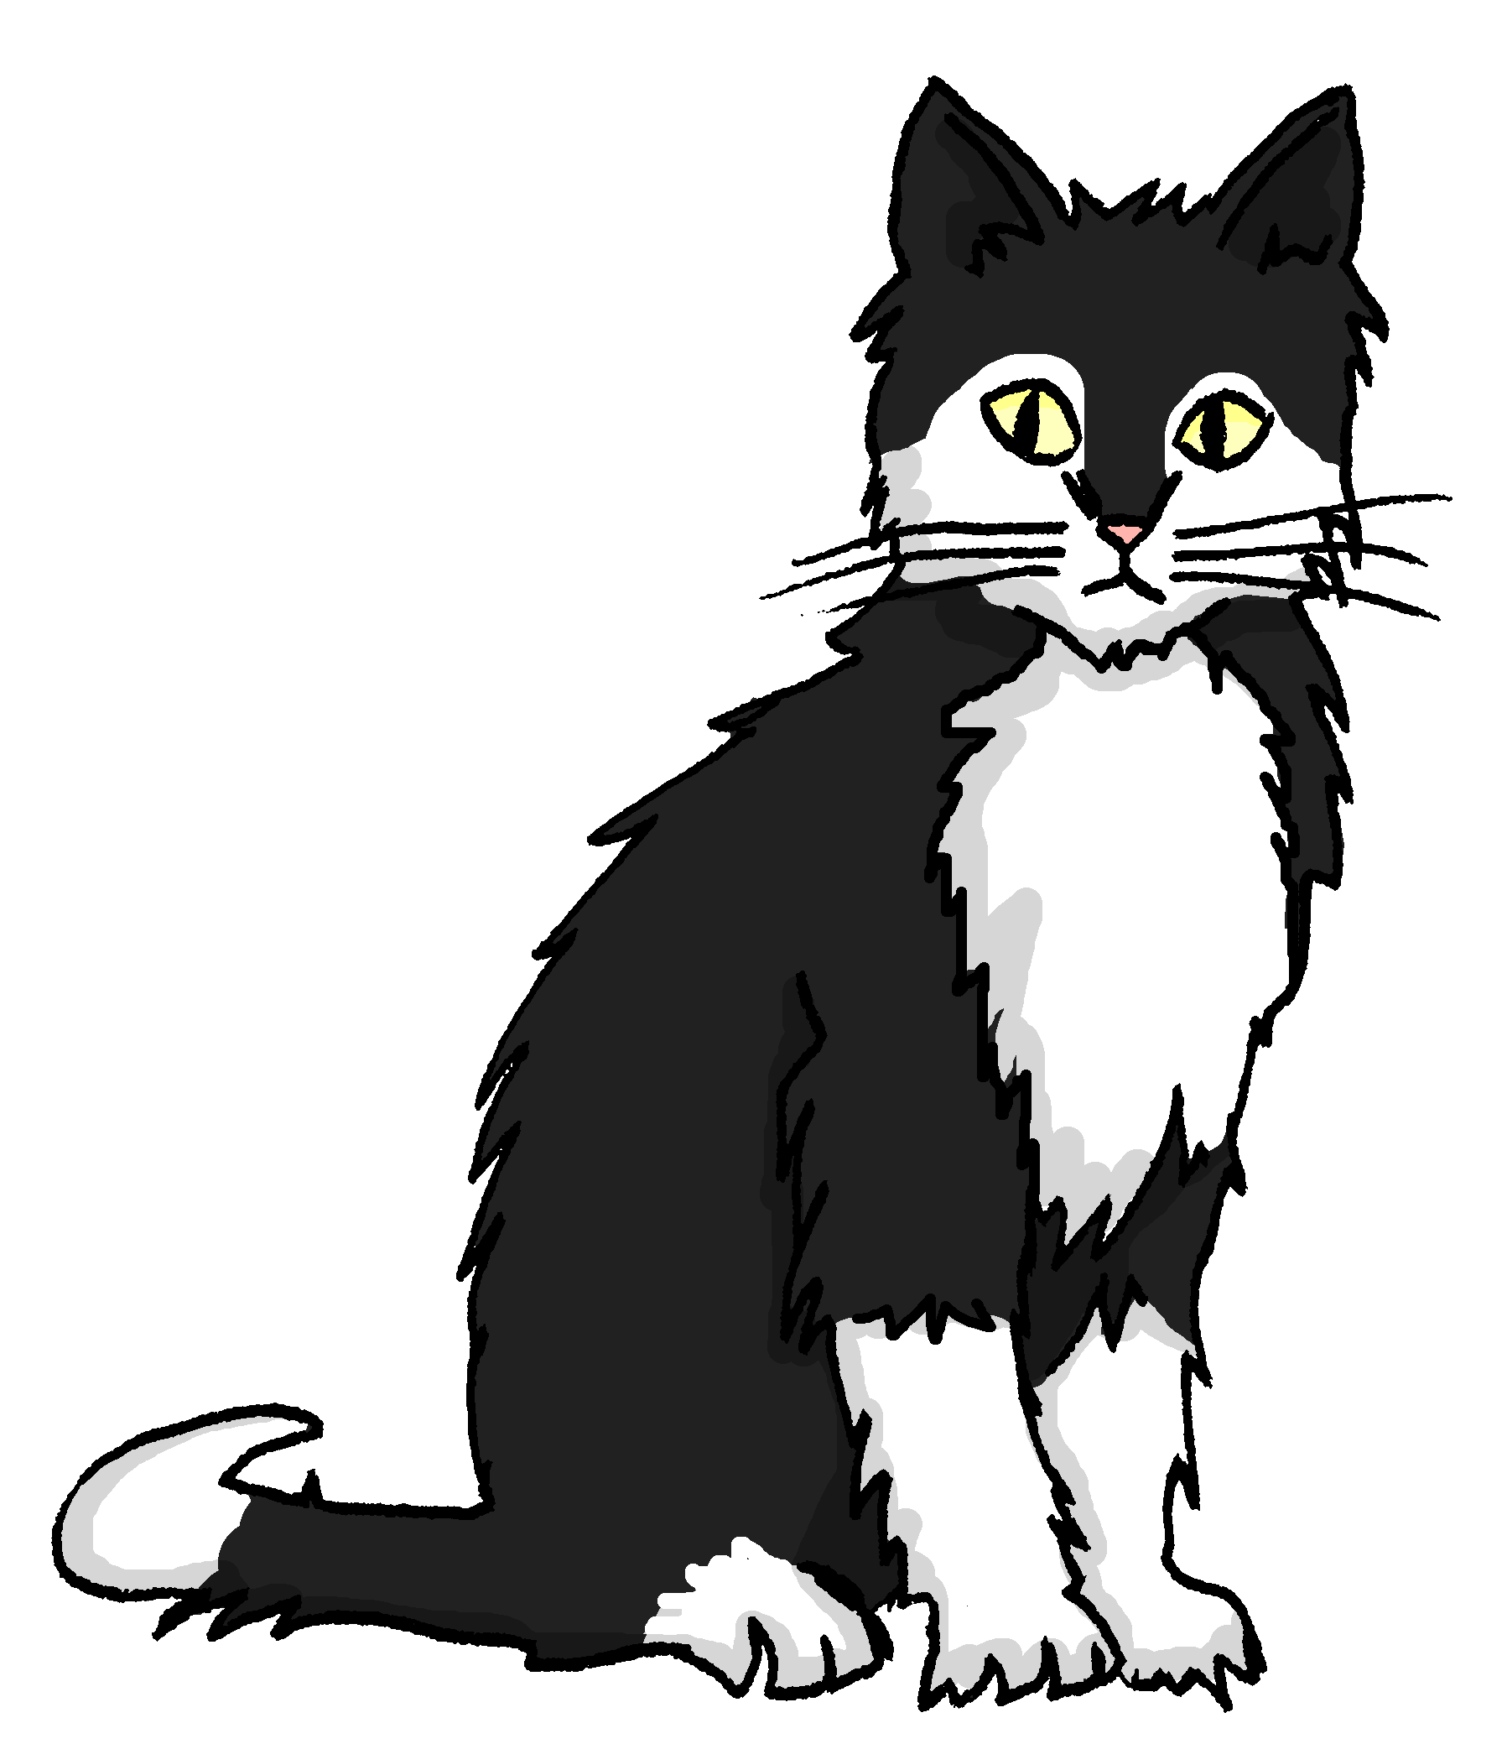
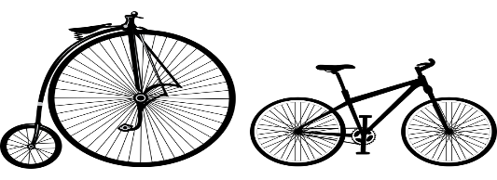
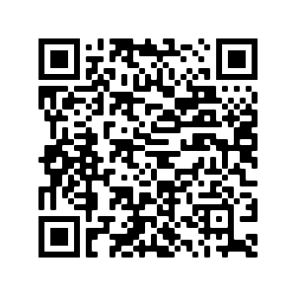
Comparing things – different and the same
Where there is a difference we compare like this:
Einstein ist größer als Mieze.
Einstein is bigger than Mieze.
Where things are the same, we compare like this:
Einstein ist (genau)so groß wie Mieze.
Einstein is (exactly) as big as Mieze.
genau (exactly) is often added to so
How things are and how they were
adj
Vokabeln
adj
billig | cheap
gefährlich | dangerous
lang | long
sicher | safe, secure
teuer | expensive
besser | better
häufig | frequent
mehr | more
noch | another/one more, still, yet, even
als | as, than
adj
adj
adj
adj
adj/adv
Revisit vocab 8.2.1.1 & 8.1.2.1
adj/adv
adv
adv
conj
41
Notes:
besser [201] billig [1738] gefährlich [1211] häufig [407] lang [97] mehr [52] sicher [265] teuer [950] noch3 [33] als2 [22]

Slide 16
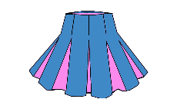

T2.2 Woche 1
Plurals: Rule 5
Grammatik
There are five main ways to form plurals in German.
Here’s a reminder of rules 1-4 – plus one new one – Rule 5!
Rule 1
Most masculine nouns add either -e at the end:
der Tag → die Tage
Remember: the word for ‘the’ is ‘die’ for all plural nouns.
Or they add an -e at the end and an umlaut on the vowel:
der Rock → die Röcke
Rule 2
Words ending in -EL or -EN or -ER are often the same in singular and plural:
das Kissen → die Kissen
der Sommer → die Sommer
Rule 3
More than 90% feminine nouns add either -n or -en at the end to form the plural:
die Frau → die Frauen
Rule 4
Some masculine and around 25% neuter nouns add -er at the end and an umlaut on the vowel (ä / ö / ü), where possible:
New
der Mann → die Männer
Some (typically ‘borrowed’) nouns add -s. They may end in in –a, -i,-o,-u-or –y (or other letters):
Rule 5
das Top → die Tops
42

Slide 17








Explaining how it is and was / used to be
Vokabeln
pron
pron
nnt
nm
adj
adj
adj
adj
adj
adj
adj
adj
adj
 | alles | everything
 | alle | everyone
 | das Kleid | dress
 | der Rock | skirt
 | alt | old
 | arm | poor
 | einfach | easy, simple
 | eng | narrow
 | genau | exact
 | hell | light, bright
 | jung | young
 | kurz | short
 | reich | rich
Revisit vocab 8.2.1.2 & 8.1.2.2
43
Notes:
alles [36] alle [36] Kleid [1780] Rock [3551] alt [138] arm [1475] einfach [131] eng [59] genau [167] hell [1411] jung [199] kurz [176] reich [1568]

Slide 18



T2.2 Woche 2
Grammatik
Separable verbs – singular and plural
Remember that separable verbs are made up of two parts:
a particle and the main verb.
In the present tense, the particle moves to the end.
Present tense verb endings!
SUBJECT
VERB
ADVERB
PARTICLE
ich
stehe
früh
auf.
I get up early.
du
stehst
früh
auf.
You get up early.
er/sie/es
steht
früh
auf.
He/she/it gets
up early.
The we and they/you (polite) forms of the verb are the same as the infinitive (aufstehen = to get up):
wir
stehen
früh
auf.
We get up early.
sie/Sie
stehen
früh
auf.
They/you (polite)
get up early.
Remember that sie (they) and Sie (you – formal) sound the same!
It is the context that tells you the correct meaning.
Sie
you (polite)
sie
they
Frau Nowak
44
Notes:
antworten [826] danken [1276] kriegen [724] schenken [1614] dir [244] ihm [91] ihr [27] Uhr² [348] eigen [166] für [17]

Slide 19



Strong verbs
The verb ending tells you which ‘sie’ it is!
This sie means they.
This sie means she.
Remember that strong verbs change their spelling in the du and er/sie/es forms. This is true for both separable and inseparable verbs:
sie nimmt den Zug sie nehmen den Zug
sie nimmt den Preis an sie nehmen den Preis an
sie fängt den Ball sie fangen den Ball
sie fängt um elf Uhr an sie fangen um elf Uhr an
sie sieht das Flugzeug sie sehen das Flugzeug
sie sieht gesund aus sie sehen gesund aus
sie
they
sie
she
Everyday life experiences
Vokabeln
vb
vb
vb
vb
vb
vb
vb
vb
nm
annehmen | to accept
anschauen | to watch, look at
aufhören | to stop, stopping
aufstehen | to get up, getting up
aussehen | to appear, look
fangen | to catch
rufen | to call
schauen | to look, looking
der Preis | prize
Revisit vocab 8.2.1.5 & 8.1.2.3.
45

Slide 20




T2.2 Woche 3
Grammatik
Using the adverb lieber to express a preference
As you know, the adverb of manner gern comes after a verb and before a noun (object):
SUBJECT
VERB
ADVERB
NOUN
Ich spiele gern Tennis…
I like playing tennis…
The adverb lieber comes in exactly the same place:
…aber ich spiele lieber Golf.
…but I prefer playing golf.
Using the adverb statt to say ‘instead of’
Use statt in combination with zu and an infinitive:
Wir müssen heute Hausaufgaben machen , statt Fußball zu spielen.
We have to do homework today instead of playing football.
Always use a comma here!
Talking about what you and others prefer to do
Vokabeln
pron
was für | what type of
die Art | type, kind
die Musik | music
die Stimme | voice
das Bild | picture
modern | modern
traditionell | traditional
besonders | particularly, especially
nf
Revisit vocab 8.2.1.6 & 8.1.2.4.
nf
nf
nnt
adj
adv
lieber | rather
statt | instead of
adj
adv
adv
46
Notes:
was für [38/17] Art [260] Bild [253] Musik [509] Stimme [399] modern [747] traditionell [1555] besonders [270] lieber [459] statt [680]

Slide 21



T2.2 Woche 4
Grammatik
Possessive adjectives ‘unser’ (our) and and ‘ihr’ (their)
You’ve already learnt the words for my, your, his, and her. Now you can add our and their:
mein
my
Das ist unsere Schule
dein
your
Das ist unsere Schule
sein
his
This is our school (R1, fem.)
ihr
her
unser
ihr (her) and ihr (their) are the same word, so you need other cues to know the meaning.
our
ihr
their
As you know, possessive adjectives work like the indefinite article ein (a/an) and change according to gender and case (row):
Das ist Andrea mit ihrer Direktorin
This is Andrea with her school principal (R3, fem.)
masculine
feminine
neuter
R1: Das ist ihr Lehrer
their teacher
R1: ihre Direktorin
their principal
R1: Das ist ihr Motto
their motto
R2: ohne ihren Lehrer
without their teacher
R2: ohne ihre Direktorin
without their prinicpal
R2: ohne ihr Motto
without their motto
R3: mit ihrem Lehrer
with their teacher
R3: mit ihrer Direktorin
with their prinicpal
R3: mit ihrem Motto
without their motto
47

Slide 22

Dative (R3) pronouns uns and ihnen
Grammatik
After certain verbs, use indirect object (R3/dative) pronouns.
For (to)us use uns, and (to)them, use ihnen:
SUBJECT
VERB
OBJECT
Sie
antworten
uns.
They
answer/are answering
us.
Wir
antworten
ihnen.
We
answer/are answering
them.
Comparing school experiences
Vokabeln
vb
erklären | to explain, explaining
erlauben | to allow, allowing
erzählen | to tell, telling
gegeben | given
geholfen | helped
ihnen | (to) them
uns | (to) us
die Wahrheit | truth
unser | our
ihr | her, (to) her, their
allein, alleine | alone
jedoch | however
ohne | without
vb
vb
vb(pp)
vb(pp)
pn
pn
nf
adj
pron/adj
Revisit vocab 8.2.2.1 & 8.1.2.5.
adv
adv
prep
48
Notes:
erklären [238] erlauben [963] erzählen [263] gegeben [49] geholfen [338] ihnen [125] uns [75] Geschichte2 [262] Wahrheit [1156] unser [86] ihr3 [28] alleine [267] jedoch [227] ohne [120]

Slide 23


T2.2 Woche 5
Grammatik
Using the preposition seit (since/for)
Use seit with the present tense to say when an unfinished action or state started in the past. Seit can mean both since and for!
Use seit with a point in time:
Use seit also with a time span:
If the action is finished, use the past (perfect) tense
without a preposition:
Ich lerne seit Juni Deutsch.
I have been learning German since June.
Ich lerne seit vier Wochen Deutsch.
I have been learning German for four weeks.
Ich habe vier Wochen Deutsch gelernt.
I learnt German for four weeks.
Seit is always followed by R3 (dative):
masculine
einem Monat
Ich kaufe seit…
feminine
..für meine Oma ein.
einer Woche
I’ve been shopping for my grandma for (a month).
neuter
einem Monat
Ich spiele seit zwei Jahren mit meinen Freunden in einer Band.
I’ve been playing in a band with my friends for two years.
Use –n for all R3 plural nouns – except plurals ending in –s!
49
Notes:
Template

Slide 24




Vor + R3 (dative)
Grammatik
As well as in front of, ‘vor’ can also mean ago, and is followed by Row 3 (dative).
Ich habe ihn vor einer Woche gesehen.
I saw him a week ago.
Vor is usually used with the past (perfect) tense:
Sie hat vor einem Monat Tennis gespielt.
She played tennis a month ago.
Talking about what you do, since when and how long for
Vokabeln
vb
kennen | to know, knowing
der Anwalt | lawyer
die Firma | company
die Weile | while (noun)
Deutschland | Germany
gleich | same
einmal | once
bei | at (the house of)
seit | since, for
vor | ago
nm
nf
nf
nnt
adj
adv
prep
prep
prep
Revisit vocab 8.2.2.2 & 8.1.2.7.
50
Notes:
kennen [216] Anwalt [1887] Deutschland [140] Firma [686] Firmen [686] Weile [1631] gleich [141] einmal [124] bei [29] seit [130] vor1 [50]

Slide 25










T3.1 Woche 1
Grammatik
The prepositions an (on, at) and auf (on, onto, at, in) tell us where something is, or is moving to.
Use auf with horizontal surfaces (“on top of”):
Er stellt das Paket auf den Tisch.
Die Pflanze steht auf dem Tisch.
movement: R2
location: R3
Use an with vertical surfaces (“next to, side by side”):
Sie stellt die Pflanze ans (an + das) Fenster
Das Poster hängt an der Tafel
movement: R2
location: R3
Use auf/an + Row 2 article with verbs of movement.
Use auf/an + Row 3 article with verbs of location.
51

Slide 26




Understanding a non-fiction text
Vokabeln
vb
hängen | to hang, be hanging
schützen | to protect
verdienen | to earn
der Angriff | attack
der Euro | euro
die Milliarde | billion
die Million | million
die Wand | wall (inside)
das Gesetz | law
das Unternehmen | enterprise, company
die Daten | data
an² | on¹, at²
gegen | against
laut | according to
vb
vb
nm
nm
nf
nf
nf
nnt
nnt
npl
prep
prep
prep
Revisit vocab 8.2.2.3. & 8.2.1.1.
52
Notes:
kennen [216] Anwalt [1887] Deutschland [140] Firma [686] Firmen [686] Weile [1631] gleich [141] einmal [124] bei [29] seit [130] vor1 [50]

Slide 27



T3.1 Woche 2
Grammatik
Adverbs of time give information about when we do things.
Add am to days of the week or times of day to talk about a one-off event in the future:
Mia
liest
am Dienstag
die Zeitung.
Add -s to days of the week or times of day to talk about regular events in the present:
Mia
fährt
dienstags
Fahrrad.
Das mache ich nur einmal!
Das mache ich immer!
If the sentence starts with a time adverb, the subject comes after the verb (WO2):
Abends
macht
Mia
Hausaufgaben.
Remember: the verb is always the second idea in a sentence.
53

Slide 28

zu + infinitive
Add zu to use a second verb in the infinitive in a sentence.
Top tip: no need to add zu with modal verbs! E.g. Ich will lesen - I want to read.
Ich habe keine Lust, zu singen.
I don’t have any desire to sing.
Er vergisst immer, sein Zimmer zu putzen.
He always forgets to clean his room.
Es ist wichtig, Deutsch zu lernen!
It is important to learn German!
Of course: the second verb (with zu, in the infinitive) is at the end of the sentence.
Revisit vocab from year 7
54
Notes:
kennen [216] Anwalt [1887] Deutschland [140] Firma [686] Firmen [686] Weile [1631] gleich [141] einmal [124] bei [29] seit [130] vor1 [50]

Slide 29


T3.1 Woche 3
Grammatik
The modal verb sollen is used for expectations/ obligations, and to express probability.
Expectation/obligation:
Ich soll eine Geschichte erzählen.
I should tell a story.
Du sollst nicht lachen.
You shouldn’t laugh.
Sie soll mir ein Glas geben.
She should give me a glass.
Probability:
Die Party soll jetzt anfangen.
The party should start now.
Wer soll was machen?
vb
lachen | to laugh, laughing
sollen | should, to ought to
teilen | to share, divide
verlassen | to leave, leaving
verstecken | to hide, hiding
versuchen | to try, trying
etwa | about, approximately
der Fehler | mistake
die Stunde | hour, lesson
das Gefühl | feeling
das Glas | glass
die Kosten | cost
vb
Vokabeln
vb
vb
vb
vb
pn
nm
Revisit vocab 8.2.2.4. & 8.2.1.2.
nf
nnt
nnt
npl
55
Notes:
Template

Slide 30

T3.1 Woche 4
Grammatik
Future Tense with werden
You know that you can use the present tense to talk about the future:
Nächste Woche mache ich eine Bootsfahrt.
I’m going on a boat trip next week.
You can also use the future tense: use the present tense of werden to mean ‘will’, and an infinitive verb at the end:
Nächste Woche werde ich eine Bootsfahrt machen.
Next week I will go on a boat trip.
Use the second person of werden to say ‘you will’:
Nächste Woche wirst du eine Bootsfahrt machen.
Next week you will go on a boat trip.
Use the 3rd person singular to say ‘s/he, it will’:
Nächste Woche wird sie eine Bootsfahrt machen.
Next week she will go on a boat trip.
Don’t confuse English ‘will’ with German will (want):
Nächste Woche will sie eine Bootsfahrt machen.
Next week she wants to go on a boat trip.
56

Slide 31


zu + infinitive
Grammatik
Planen (to plan), like many other verbs, uses zu and an infinitive at the end:
Ich plane , Gemüse zu essen.
I am planning to eat vegetables.
Don’t forget to add a comma before the zu!
Was wirst du machen?
Vokabeln
vb
planen | to plan, planning
werden | to become, will
er/sie/ es wird | he/she/it will
du wirst | you will
der Ausflug | outing, trip
der Eintritt | entry, admission
der Fehler | mistake
der Kurs | course, exchange rate
der Preis | prize, price
die Karte | ticket, menu, card, map
das Boot | boat
das Essen | food, meal
bald | soon
vielleicht | perhaps
vb
vb
vb
Revisit vocab 8.2.2.5. & 8.2.1.5.
nm
nm
nm
nm
nm
nf
nnt
nnt
adv
adv
57
Notes:
Template

Slide 32
T3.1 Woche 5
Grammatik
Adjective endings after definite articles - R2
You already know the adjective endings before a definite article in R1 – now you can add the endings for R2 (acc.):
 | masculine | feminine | neuter | plural
R1 | der lange Raum | die nette Dame | das neue Gesetz | die alten Züge
R2 | den langen Raum | die nette Dame | das neue Gesetz | die alten Züge
Only the masculine ending is different in R2!
Changing the word order for emphasis
You can start a German sentence with a subject, time, manner, place or object. Start with the idea you want to emphasise. Whatever happens, the verb is always second.
Jede Familie hat normalerweise ihre eigene Wohnung.
subject
verb
adverb
object
Ihre eigene Wohnung hat normalerweise jede Familie.
object
verb
adverb
subject
Normalerweise hat jede Familie ihre eigene Wohnung.
adverb
verb
subject
object
58

Slide 33




What is it like?
Describing attributes
Vokabeln
vb
pron
nm
nm
nm
nm
nf
nnt
npl
adj
adj
beschreiben | to describe
wohin | where…to
der Beruf | occupation, job
der Nachbar | neighbour
der Raum | room, space
der Stoff | material, cloth
die Dame | lady
das Foto | photo
die Sachen | things
bester, beste, bestes | best
weiß | white
Revisit vocab 8.3.1.1. & 8.2.1.6.
59
Notes:
Template

Slide 34




T3.1 Woche 6
Grammatik
Adjective endings for R3 (dative)
Good news! The R3 adjective endings are the same for both indefinite and definite articles!
 | masculine | feminine | neuter | plural
R3 | dem roten Apfel | der kleinen Tür | dem blauen Fenster | den großen Gebäuden
Plural R3 endings are always –en.
Plural nouns add –n or –en.
Use R3 endings after these prepositions:
zu
mit
nach
bei
von
seit
Also use R3 endings after these prepositions – but only when you‘re talking about location (otherwise use R2).
in
an
auf
vor
neben
hinter
60

Slide 35




Tell me more: describing in more detail
Vokabeln
nm
nm
nf
nf
nf
nnt
nnt
adj
prep
prep
prep
der Baum | tree
der Teil | part
die Nähe | vicinity, nearby area
die Seite | page, side
die Universität | university
das Gebäude | building
das Feld | field
bekannt | well-known, famous
aus | out, out of, from
hinter | behind
neben | next to, beside
Revisit vocab 8.3.1.3. & 8.2.2.1.
61
Notes:
Template

Slide 36

T3.2 Woche 1
Grammatik
Perfect tense with haben and sein
The perfect tense generally uses the present tense of the verb ‘to have’ haben together with a past participle:
ich habe aus dem Fenster geschaut.
I looked out of the window.
du hast Hallo gerufen.
You called ‘Hello!.
er/sie/man hat die Reise geplant.
S/he, you planned the trip.
wir haben ein Hotel gesucht.
We looked for a hotel.
Sie haben uns geholfen.
You (formal) helped us.
sie haben uns ein Zimmer gefunden.
They found us a room.
With certain verbs of movement, use the present tense of ‘to be’ (sein) and a past participle:
Note the 3 different meanings of sie/Sie!
ich bin nach unten gegangen.
I went downstairs.
du bist gewandert.
You walked.
er/sie/man ist ins Wasser gefallen.
S/he, you fell into the water.
wir sind mit der Bahn gefahren.
We went by rail.
Sie sind geflogen.
You (formal) flew.
sie sind an den Strand gegangen.
They went to the beach.
62

Slide 37



Wie spät ist es? Half past the hour
Grammatik
Use halb (half) to mean half to the next hour!
Es ist halb vier.
It is half past three.
Um halb vier.
At half past three.
Um before Uhr (o’clock) means at
What you did when
Vokabeln
vb
vb (pp)
vb
vb (pp)
nm
nf
nf
nnt
adj
adj
prep
prep
bringen | to bring
gebracht | brought
verlieren | to lose
verloren | lost
der Wind | wind
die Insel | island
die Reise | journey
das Meer | sea, ocean
halb | half
stark | strong
nach² | to, towards¹, after²
vor³ | ago¹, in front of², before³
Revisit vocab 8.3.1.4. & 8.2.2.2.
63
Notes:
Template

Slide 38










T3.2 Woche 2
Grammatik
As in English, use ordinal numbers to talk about dates:
Add -te to the numbers 1-19:
Heute ist der neunte Juli.
Today is the ninth of July.
Add -ste to numbers 20+:
Heute ist der zwanzigste August.
Today is the twentieth of August.
To say ‘on the’ use an + dem to make am:
Das Konzert ist am neunten Juli.
The concert is on the ninth of July.
Nein! Es ist am zwanzigsten Juli.
No! It is on the twentieth of July.
Note: After ‘am’ also add -n to the number.
Revisit all the vocabulary from this year:
64

Slide 39





T3.2 Woche 4
Goethe war ein deutscher Dichter, Denker, Anwalt und Wissenschaftler. Sein Werk Faust ist besonders bekannt.
Goethe was a German poet, thinker, lawyer and scientist.
His work Faust is particularly famous.
Johann Wolfgang von Goethe
1749-1932
Working with a literary text
Vokabeln
vb
vb
vb
vb
vb
nm
nm
nf
nnt
adj
adj
adj
adj
adv
adv
fassen | to grab, grasp
führen | to lead
scheinen | to appear, seem
versprechen | to promise, promising
warten | to wait, waiting
der Arm | arm
der König | king
die Tochter | daughter
das Blatt | leaf, sheet
lieb | dear, kind
mancher, mancher, manches | some, many a
tot | dead
warm | warm
gar (nicht) | (not) at all
wohl | well
65
Notes:
Template

Slide 40


T3.2 Woche 5
Grammatik
Future Tense - revisited
One way to talk about the future in German is to use the present tense of werden and a verb in the infinitive:
ich werde früh aufstehen.
I will get up early.
du wirst zu Hause helfen.
You will help at home.
er/sie/es wird Rad fahren.
S/he, it will go by bike.
You can also use the present tense to talk about the future:
Present tense + time adverb:
Nächste Woche sehe ich einen Film.
Next week I am seeing a film.
Always remember to switch the pronoun and verb in questions:
Kochst du morgen?
Are you cooking tomorrow?
Are you going to cook tomorrow?
Wirst du morgen kochen?
Will you cook tomorrow?
Wann wirst du morgen kochen?
When are you going to cook tomorrow?
When will you cook tomorrow?
Revisit vocab 8.3.1.6 & 8.2.2.4.
In English we say either 'will' or 'going to' for future plans.
66

Slide 41




T3.2 Woche 6
Grammatik
Saying ‘when’ and ‘if’
To ask ‘when?’ in a question, use wann:
Wann schwimmst du im Meer?f
When do you swim in the sea?
To say ‘when’ in a statement in the present, use wenn:
Ich schwimme im Meer , wenn ich auf die Insel fahre.
I swim in the sea when I go to the island.
Depending on the context, wenn can also mean ‘if’:
Ich schwimme im Meer , wenn kein starker Wind ist.
I swim in the sea if there is no strong wind.
Unlike in English, there is always a comma before wenn in German.
The word ‘wenn’ kicks the verb to the end of the clause
– just like ‘weil’ and ‘dass’!
Used like this, wenn is a conjunction like ‘weil’.
It connects a main clause with a condition on which it depends.
67

Slide 42








T3.2 Woche 6
Grammatik
aus (out of, from) and von (from)
Aus means out of when talking about movement, and is followed by the dative case (R3 endings):
Sie kommt aus …
dem Apfel
der Tür
dem Fenster
Aus can also mean from when used with a country or city name to talk about someone’s origins:
Sie kommt aus …
der Schweiz
Von means from for a starting point in a journey:
Er kommt von Berlin (und fährt nach München).
vb
vb
nf
nf
nf
nm
adj
conj
prep
prep
num
bauen | to build, building
studieren | to study, studying
die Ausbildung | training
die Freizeit | free time
die Karriere | career
der Traum | dream
relativ | relatively
wenn¹² | if¹, when²
aus² | from²
pro | per
tausend | thousand
Vokabeln
Revisit vocab 8.3.2.1 & 8.2.2.5.
68

Slide 43





T3.2 Woche 7
Grammatik
Pronouns in R1, R2 and R3
Like nouns, pronouns also change according to which row/case they’re in.
R1 |  | R2 |  | R3
ich | I | mich | me | mir | (to) me
du | you | dich | you | dir | (to) you
er | he | ihn | him | ihm | (to) him
sie | she | sie | her | ihr | (to) her
es | it | es | it | ihm | (to) it
sie | they | sie | them | ihnen | (to) them
R1 (Nominative): for subject of the sentence
R2 (Accusative): for the definite object
R3 (Dative): for the indefinite object.
R1: subject
verb
R2: direct object
ich
mag
dich.
I like you.
R1: subject
verb
R3: indirect object
ich
glaube
dir.
I believe you.
Revisit vocabulary from this year:
69

Slide 44
The Foreign Language Translation Bee – Word list
You have one minute to translate as many sentences (made up of words from this list) into German, as possible.You must say pass in German → ich passe. Pronunciation is important!
 | Word list | Y7 | Y8 | Frequency
1 | fahren | Y |  | 215
2 | essen | Y |  | 323
3 | trinken | Y |  | 634
4 | lernen | Y |  | 288
5 | spielen | Y |  | 205
6 | gehen | Y |  | 66
7 | wohnen | Y |  | 560
8 | kaufen |  | Y | 506
9 | Spanien |  | Y | 1745
10 | Frankreich |  | Y | 813
11 | Deutschland |  | Y | 140
12 | Italien |  | Y | 1204
13 | Österreich | Y |  | 707
14 | der Bus | Y |  | 1562
15 | der Zug | Y |  | 675
16 | das Auto | Y |  | 361
17 | das Flugzeug |  | Y | 1776
18 | die U-Bahn |  | Y | 1415 (Bahn)
19 | die Pizza | Y |  | >5009
20 | die Pommes |  | Y | >5009
21 | das Obst | Y |  | 4980
22 | der Salat |  | Y | >5009
23 | der Reis |  |  | >5009
24 | der Orangensaft |  |  | >5009
25 | das Wasser | Y |  | 245
26 | die Limonade |  |  | >5009
 | Word list | Y7 | Y8 | Frequency
27 | der Tee |  | Y | 2617
28 | der Kaffee |  | Y | 1299
29 | Deutsch | Y |  | 112
30 | Französisch |  | Y | 816
31 | Spanisch |  | Y | 1919
32 | Englisch | Y |  | 662
33 | Mathe | Y |  | 1636
34 | Naturwissen-schaften | Y |  | 4425
35 | Theater |  | Y | 1086
36 | Kunst | Y |  | 554
37 | Erdkunde |  |  | >5009
38 | Geschichte |  | Y | 262
39 | Fußball | Y |  | 1277
40 | Basketball |  |  | >5009
41 | Tennis | Y |  | 4671
42 | Golf |  |  | >5009
43 | Hockey |  |  | >5009
44 | Rugby |  |  | >5009
45 | Karten |  | Y | 1474
46 | Tischtennis | Y |  | >5009
47 | Federball |  |  | >5009
48 | Volleyball |  |  | >5009
49 | das Kino | Y |  | 2020
50 | das Theater | Y |  | 1086

Slide 45
The Foreign Language Translation Bee – Cont’d
Stage 1: Present tense
Stage 2: Present and future
Stage 3: Present, future and past (perfect)
 | Word list | Y7 | Y8 | Frequency
51 | das Restaurant |  |  | 1802
52 | die Schule | Y |  | 359
53 | nach Hause | Y |  | 34/147
54 | das Dorf | Y |  | 959
55 | die Stadt | Y |  | 204
56 | das Land | Y |  | 134
57 | die Küste |  | Y | 2628
58 | der Berg |  | Y | 934
59 | das T-Shirt |  |  | 3914
60 | das Hemd |  |  | 2657
61 | das Kleid |  | Y | 1780
62 | der Rock |  | Y | 3551
63 | der Pulli |  |  | >5009
64 | die Jacke | Y |  | 3287
65 | die Hose | Y |  | 2156
66 | die Socke |  |  | >5009
67 | der Schuh |  | Y | 1678
68 | der Turnschuh |  |  | >5009
69 | mit | Y |  | 13
70 | nach | Y |  | 34
71 | in | Y |  | 3
72 | auf | Y |  | 16
73 | an | Y |  | 19

